Slide 1
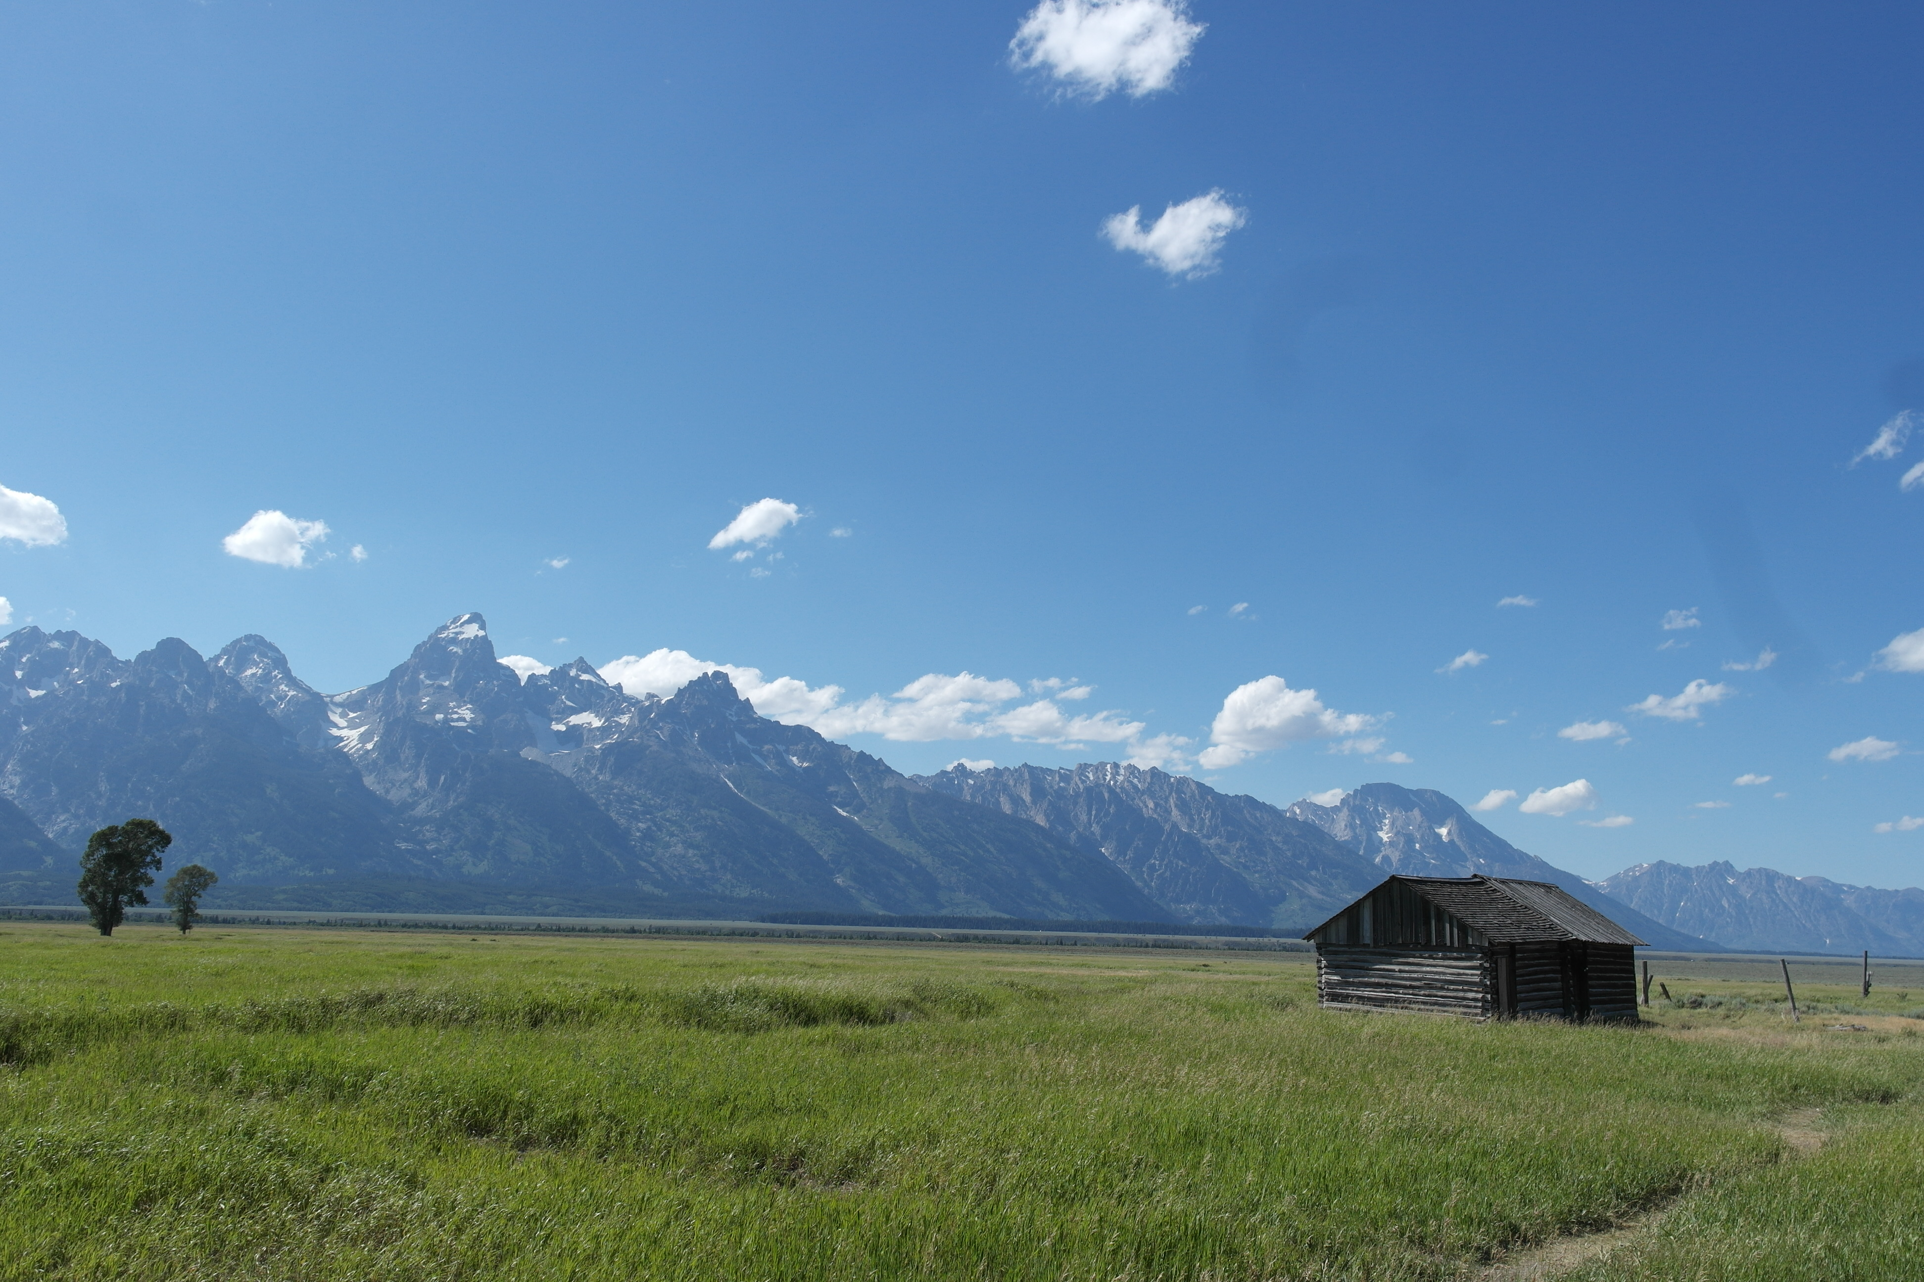
Decision Trees - Classification
Daniel Eldridge
Grand Teton National Park

Slide 2
Outline
Motivation
Decision Trees – Classification
Intuition
Predictions
Splitting Criteria
Stopping Conditions
Decision Trees - Regression

Slide 3
Outline
Motivation
Decision Trees – Classification
Intuition
Predictions
Splitting Criteria
Stopping Conditions
Decision Trees - Regression

Slide 4

When you're trying to be one with nature, but someone mentions food

Slide 5


Slide 6

Motivation
The simplest and most straightforward classification model we know is logistic regression.
Logistic regression works best when:
The classes are well-separated in the feature space, and
The classification boundary has a nice geometry
Logistic Regression

Slide 7

Motivation
Classification Boundaries or Decision Boundaries are defined where the probabilities of being in class 1 and class 0 are equal, i.e.
$$P\left(Y=1\right)=P\left(Y=0\right)=1−P\left(Y=1\right)$$

Slide 8



Motivation
Classification Boundaries or Decision Boundaries are defined where the probabilities of being in class 1 and class 0 are equal, i.e.
$$P\left(Y=1\right)=P\left(Y=0\right)=1−P\left(Y=1\right)$$
$$\underset{⇒}{ } P\left(Y=1\right)=0.5$$
$$P\left(Y=1\right)=P\left(Y=0\right)=1−P\left(Y=1\right)$$
which is equivalent to when the log-odds are zero:
$Xβ=0$
This equation defines a line or a hyperplane.

Slide 9
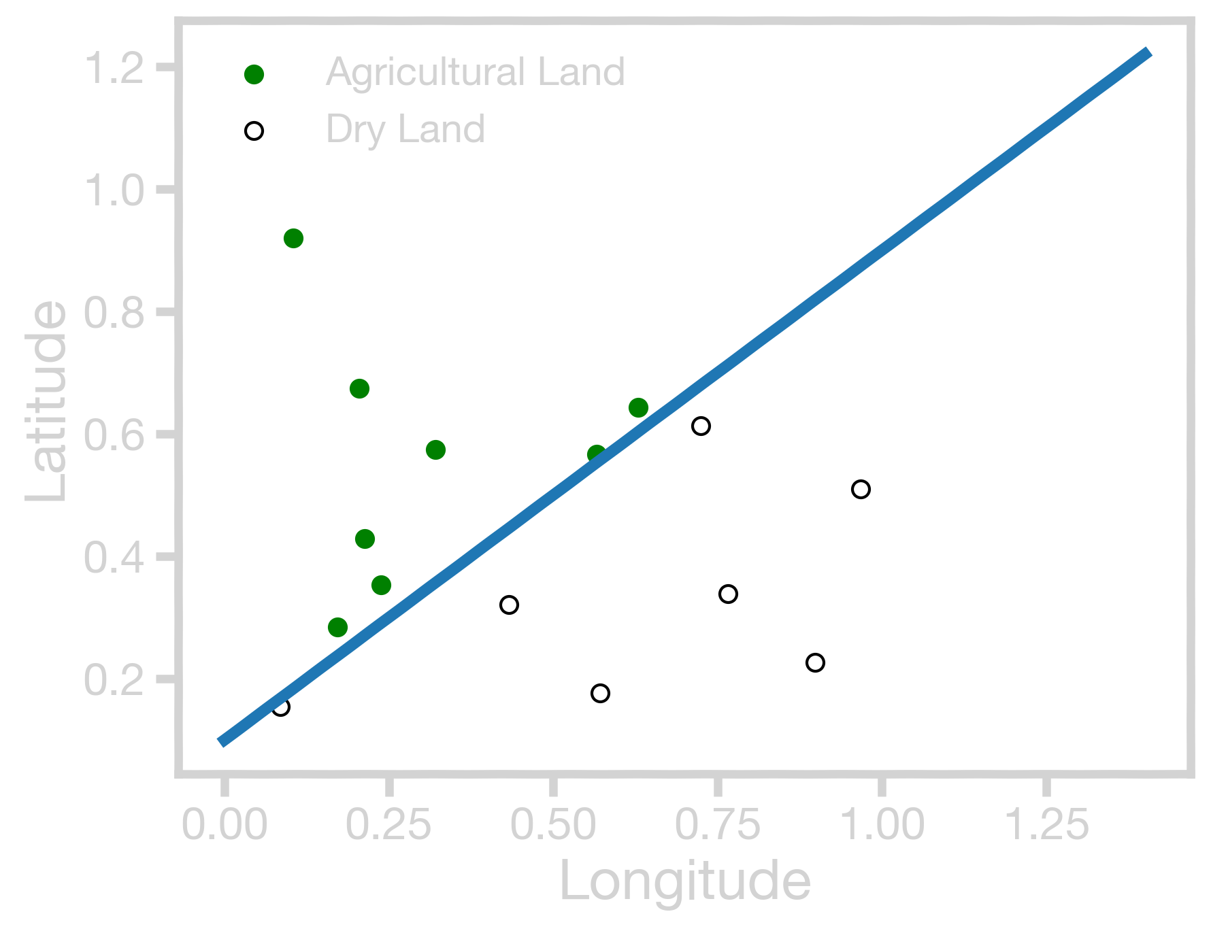

Motivation
For example, the equation that defines the decision boundary shown with a blue line in the figure is:
$Latitude=0.8 Longitude+0.1$
$$or$$
$−0.8Longitude+Latitude− 0$.1 = 0

Slide 10
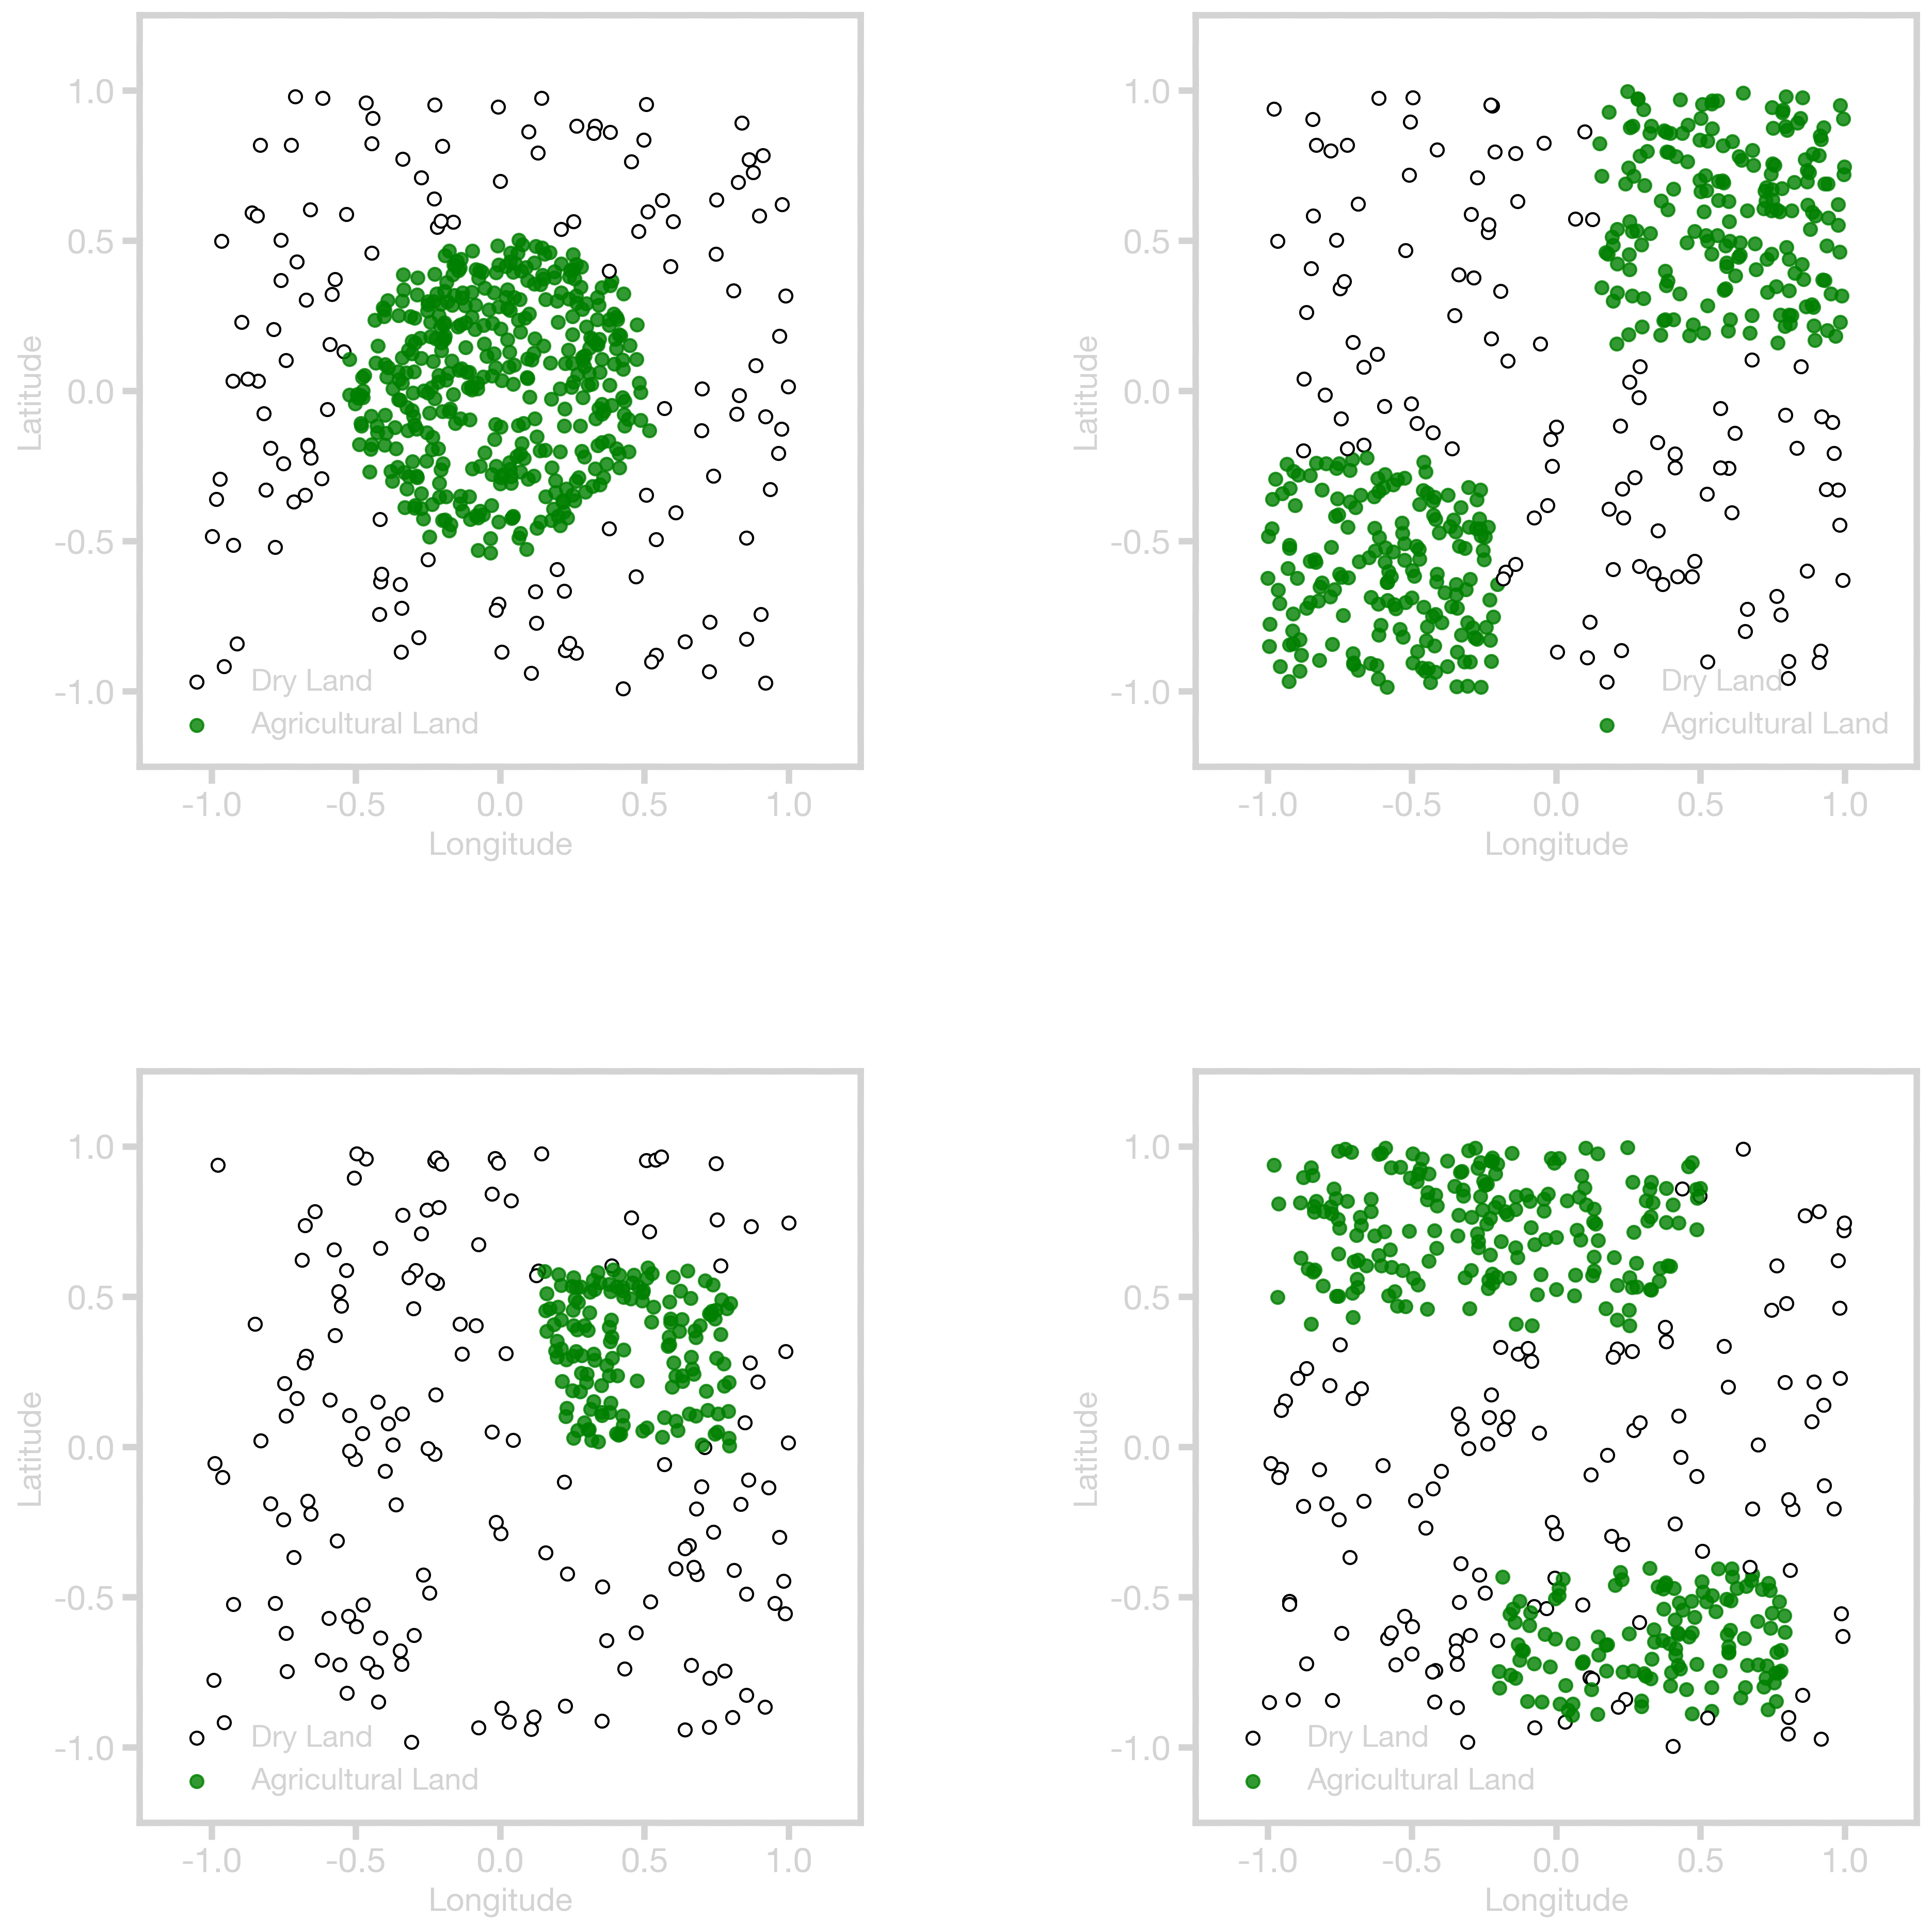
Motivation
This works well when the classification boundary has a nice simple geometry, but what about these?

Slide 11
Motivation
Or these?

Slide 12
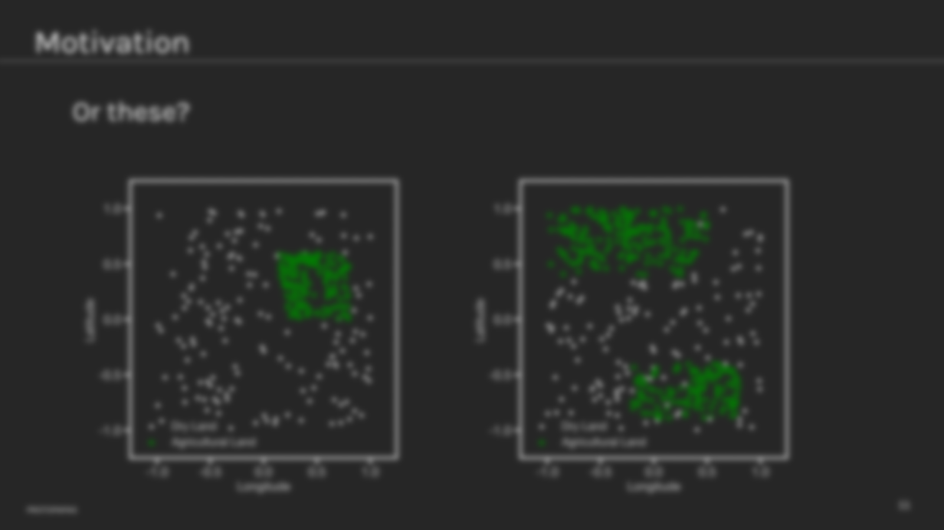

Motivation
Or these?
Confused?

Slide 13
Motivation
In such datasets the classes are still well-separated in the feature space, but the decision boundaries cannot easily be described by a single equation.

Slide 14

Motivation
Logistic regression models with linear boundaries are intuitive to interpret by examining the impact of each predictor on the log-odds of a positive classification. It is less straightforward to interpret nonlinear decision boundaries in context.
$$x_{1}^{2}+x_{2}^{2}−0.25=0$$

Slide 15

Motivation
The modeling wish list:
We would like to have models that
Allow for complex decision boundaries, and
Are also easy to interpret.

Slide 16
Interpretable Models
People in every walk of life have long been using interpretable models for differentiating between classes of objects and phenomena.
For example, the Engineering Flowchart:
Engineering Flowchart

Slide 17

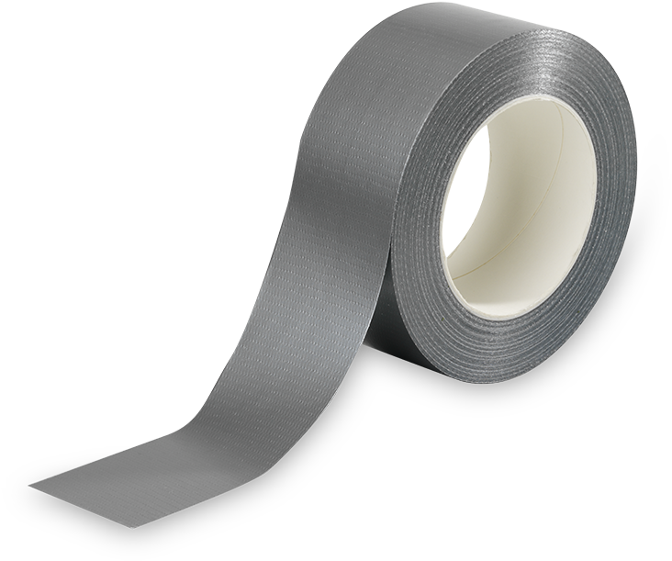
Engineering Flowchart
Does it move?
No
Yes
Should it?
Should it?
No
Yes
No
Yes
No problem
No problem

Slide 18

Interpretable Models
It turns out that the simple flow chart in our example can be formulated as a mathematical model for classification, and this model has the properties we desire:
The model is interpretable by humans.
It has sufficiently complex decision boundaries.
The decision boundaries are locally linear, which means each component of the decision boundary is simple to describe mathematically.

Slide 19
Outline
Motivation
Decision Trees – Classification
Intuition
Predictions
Splitting Criteria
Stopping Conditions
Decision Trees - Regression

Slide 20
Example
A decision tree to classify fruits into lemons and oranges:
Root node
height > 6.5?
Internal Nodes
No
Yes
width > 6.0?
width > 9.5?
No
Yes
No
Yes
}
Leaf Nodes

Slide 21
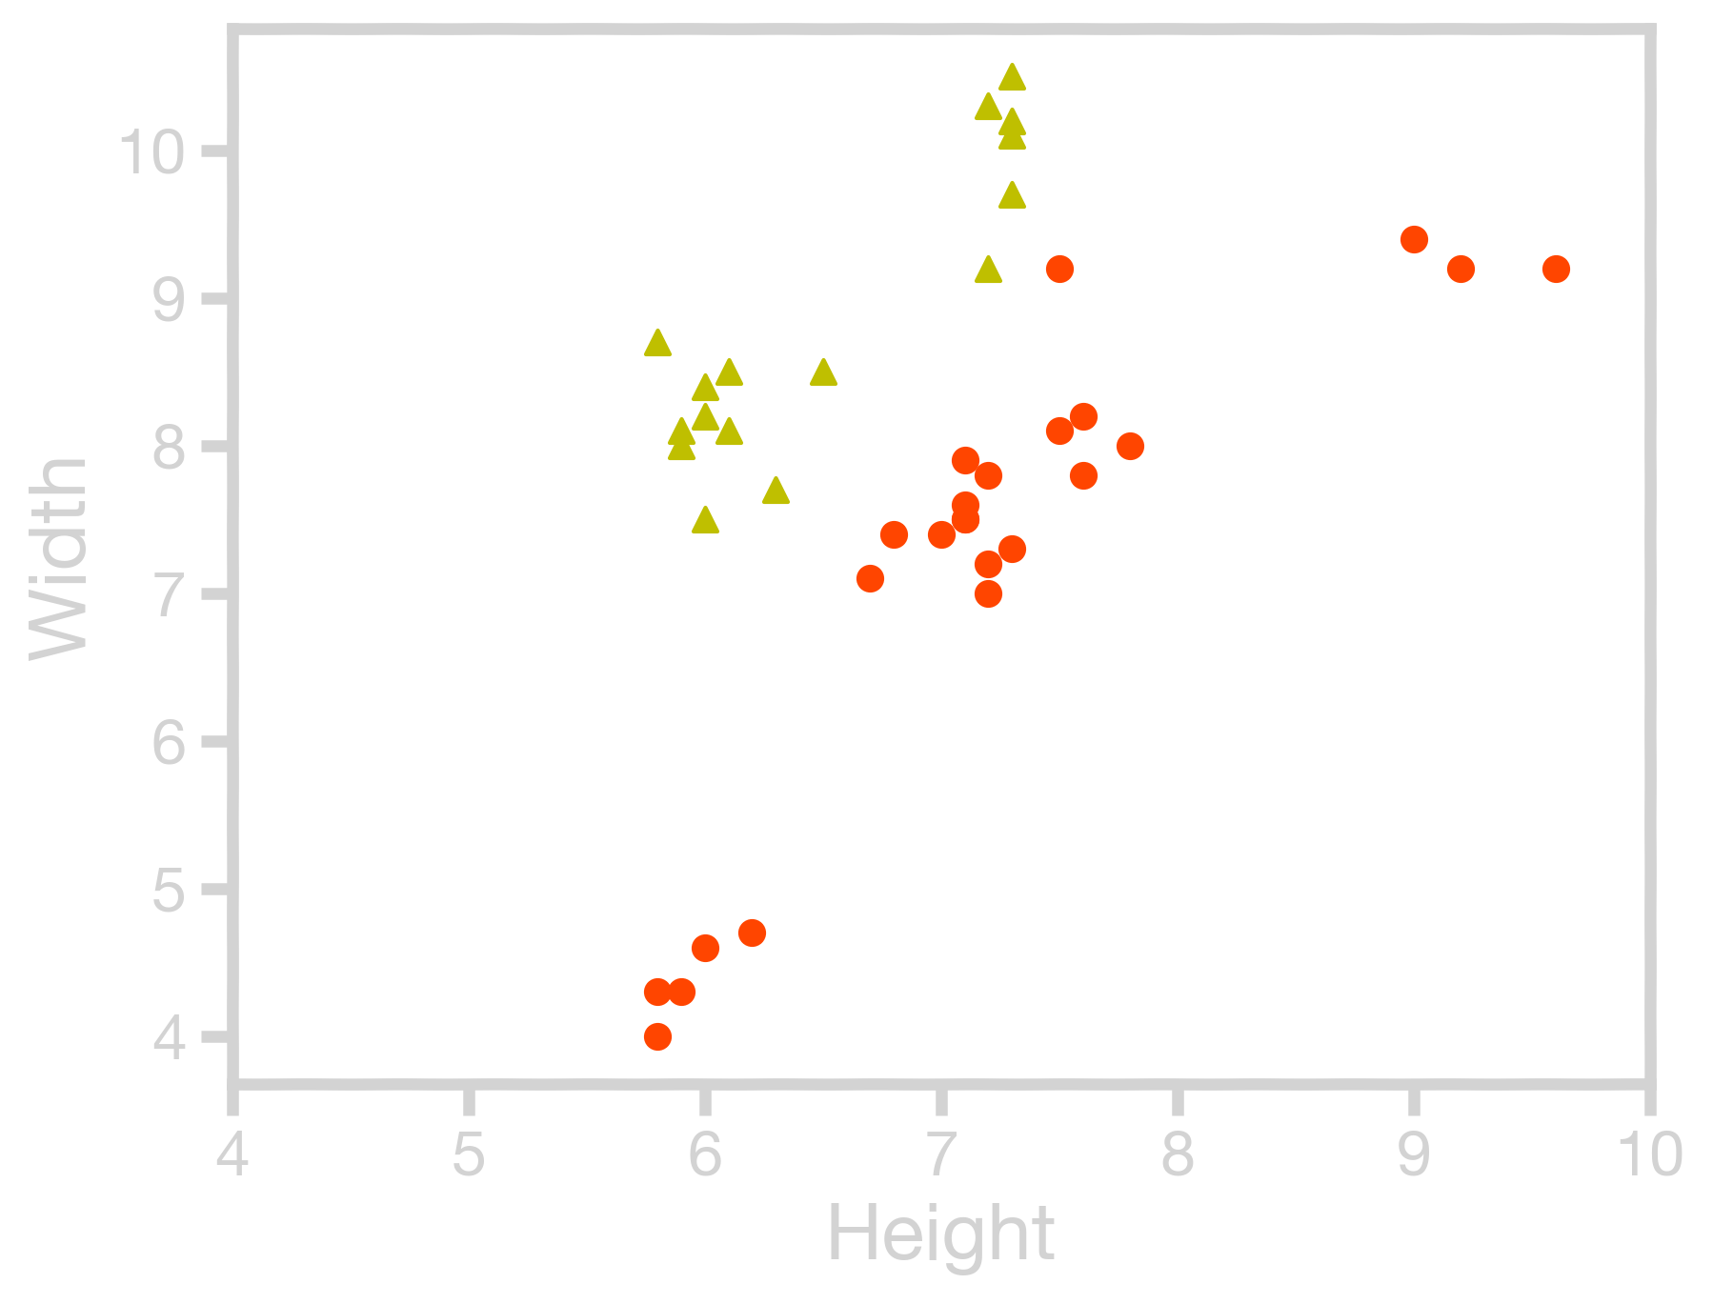
The Geometry of Flow Charts
Every branch of the flow chart tree corresponds to a partition of the feature space by lines parallel to the axis or (hyper) planes. Conversely, every such partition can be written as a branch of the flow chart tree.

Slide 22
The Geometry of Flow Charts
Every branch of the flow chart tree corresponds to a partition of the feature space by lines parallel to the axis or (hyper) planes. Conversely, every such partition can be written as a branch of the flow chart tree.
height > 6.5?
Yes

Slide 23
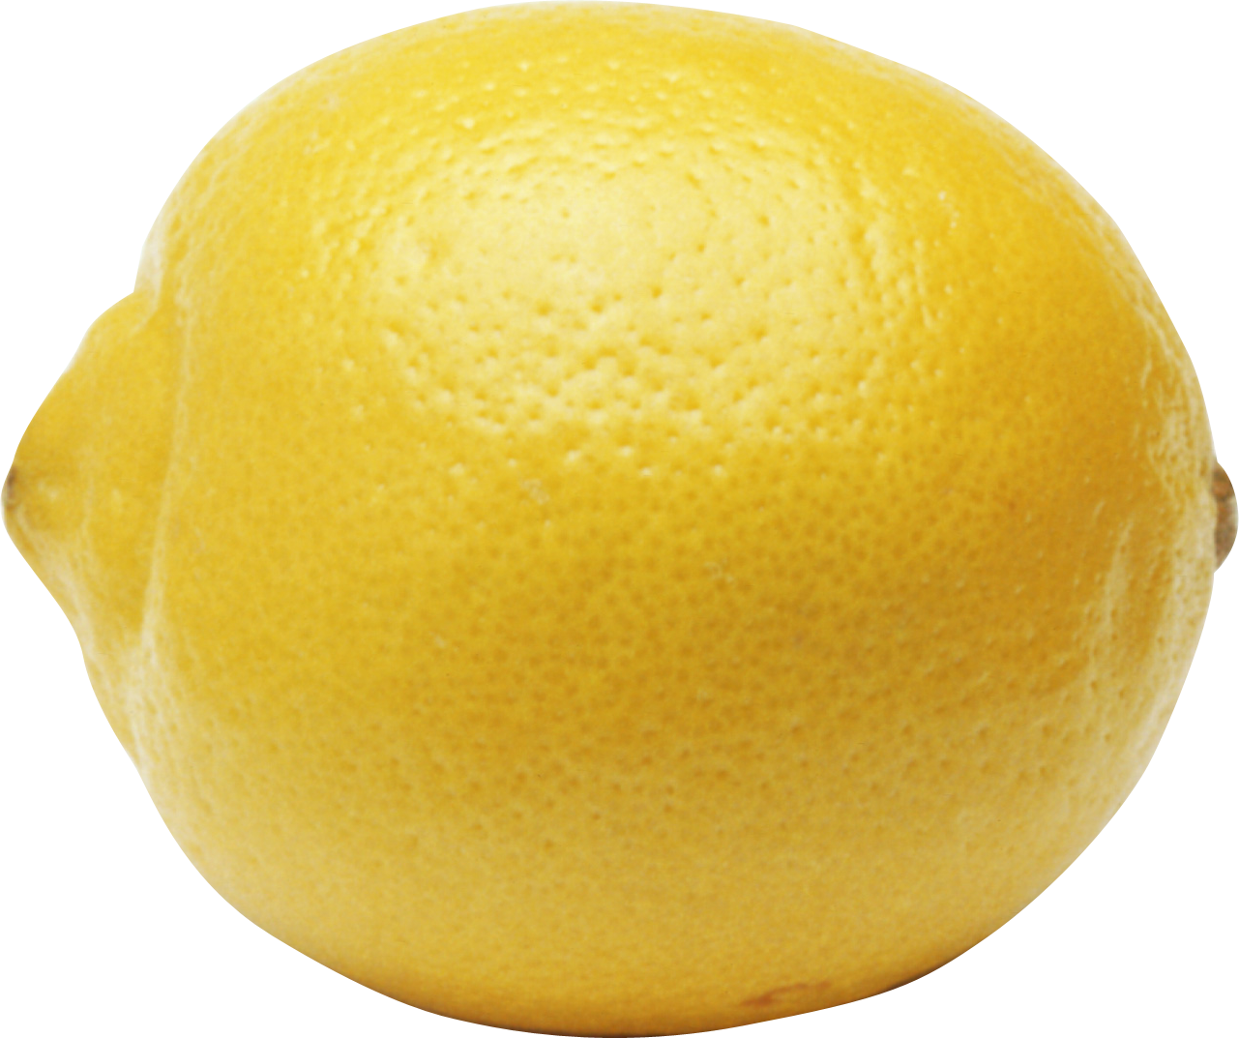
The Geometry of Flow Charts
Every branch of the flow chart tree corresponds to a partition of the feature space by lines parallel to the axis or (hyper) planes. Conversely, every such partition can be written as a branch of the flow chart tree.
The majority here are lemons. Let us call everything that fall in this area lemon
height > 6.5?
Yes
width > 9.5?
No
Yes
The majority here are oranges. Let us call everything that fall in this area an orange

Slide 24
The Geometry of Flow Charts
The final decision boundary
height > 6.5?
No
Yes
width > 6.0?
width > 9.5?
No
Yes
No
Yes

Slide 25
Outline
Motivation
Decision Trees – Classification
Intuition
Predictions
Splitting Criteria
Stopping Conditions
Decision Trees - Regression

Slide 26
Predictions
Let’s use the decision tree from before to make predictions.
height > 6.5?
No
Yes
width > 6.0?
width > 9.5?
No
Yes
No
Yes

Slide 27
Predictions
?
height = 5.9
width = 5.8
height > 6.5?
No
Yes
width > 6.0?
width > 9.5?
No
Yes
No
Yes

Slide 28
Predictions
?
height = 5.9
width = 5.8
height > 6.5?
No
Yes
width > 6.0?
width > 9.5?
No
Yes
No
Yes

Slide 29
Predictions
?
height = 5.9
width = 5.8
height > 6.5?
No
Yes
width > 6.0?
width > 9.5?
No
Yes
No
Yes

Slide 30
Predictions
?
height = 5.9
width = 5.8
height > 6.5?
No
Yes
width > 6.0?
width > 9.5?
No
Yes
No
Yes

Slide 31
Predictions
?
height = 5.9
width = 5.8
height > 6.5?
No
Yes
width > 6.0?
width > 9.5?
No
Yes
No
Yes

Slide 32
Predictions
height = 5.9
width = 5.8
height > 6.5?
No
Yes
width > 6.0?
width > 9.5?
No
Yes
No
Yes
THIS METHOD IS ALSO CALLED TRAVERSING THE TREE.

Slide 33
Outline
Motivation
Decision Trees – Classification
Intuition
Predictions
Splitting Criteria
Stopping Conditions
Decision Trees - Regression

Slide 34
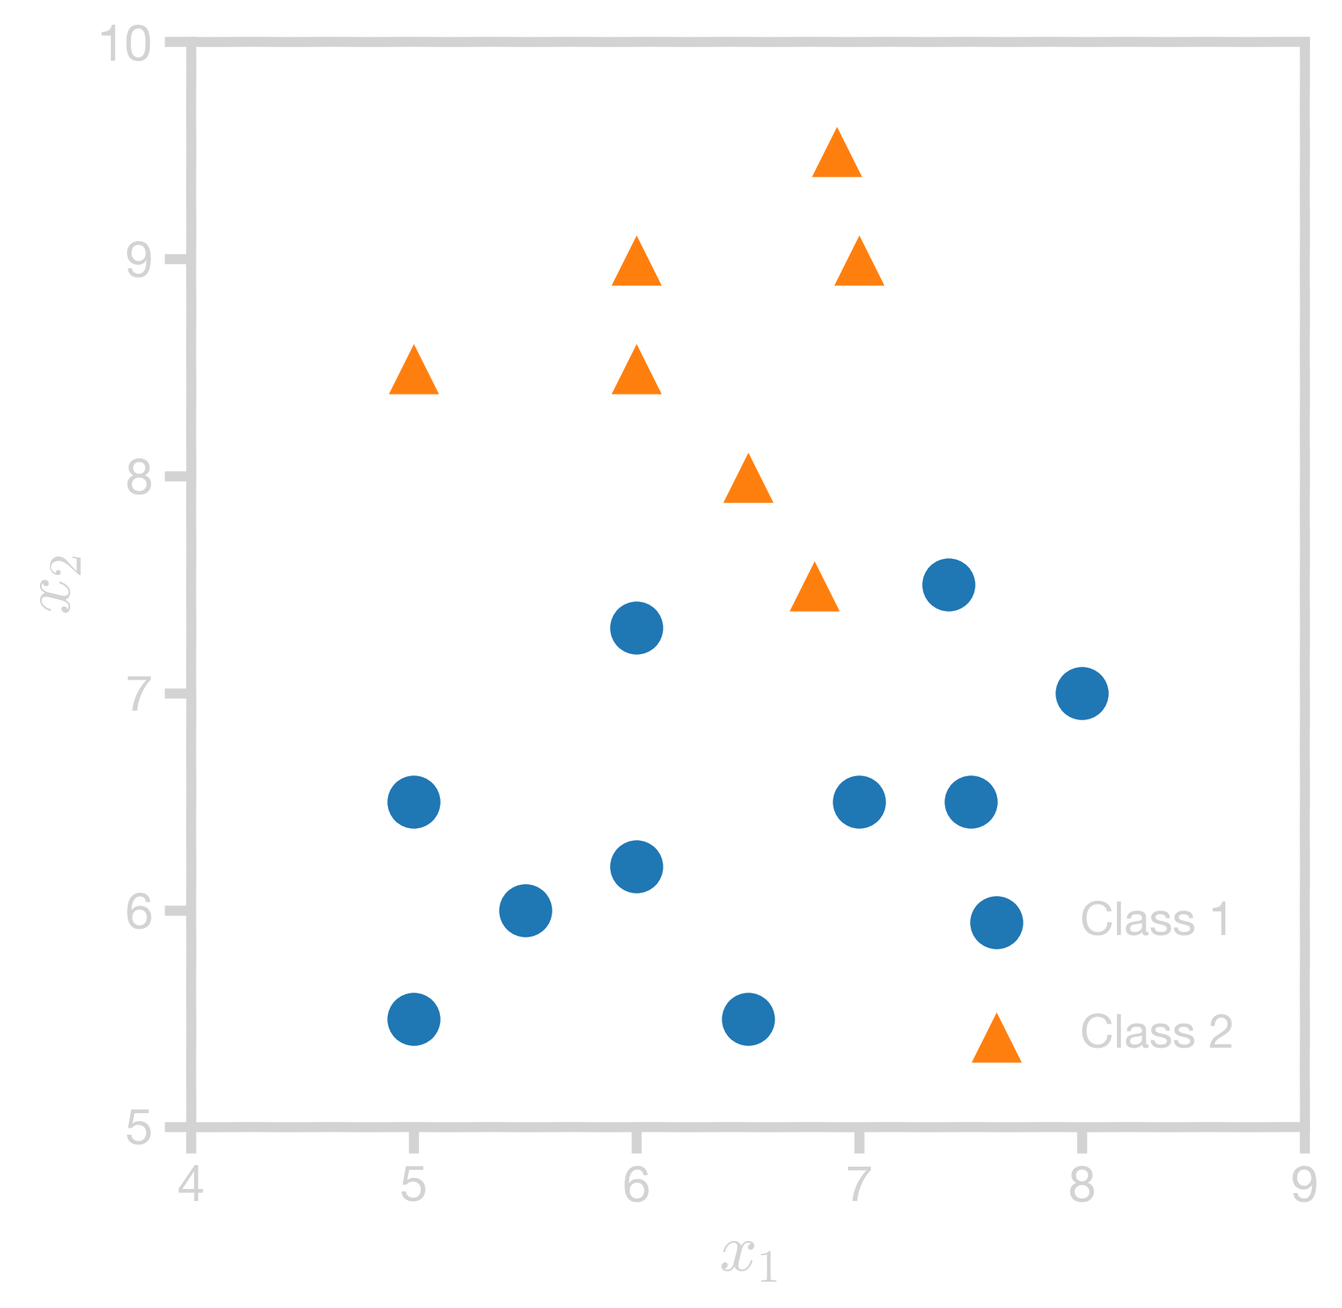


Splitting Criteria
Which gives a better split?
Should it be split along $x_{1}$ or $x_{2}$?
Where should we split?

Slide 35
Splitting Criteria
Which gives a better split?
Should it be split along $x_{1}$ or $x_{2}$?
Where should we split?

Slide 36
Splitting Criteria
Which gives a better split?
Should it be split along $x_{1}$ or $x_{2}$?
Where should we split?

Slide 37
Splitting Criteria
Which gives a better split?
Should it be split along $x_{1}$ or $x_{2}$?
Where should we split?

Slide 38
Optimality of Splitting
While there is no ‘correct’ way to define an optimal split, there are some common-sense guidelines for every splitting criterion:
The regions in the feature space should grow progressively purer with the number of splits. That is, we should see that each region ‘specializes’ towards a single class.
We should end up with no empty regions – every region should contain training points.
The fitness metric of a split should take a differentiable form (making optimization possible).
Pavlos is not convinced we need differentiable metric

Slide 39
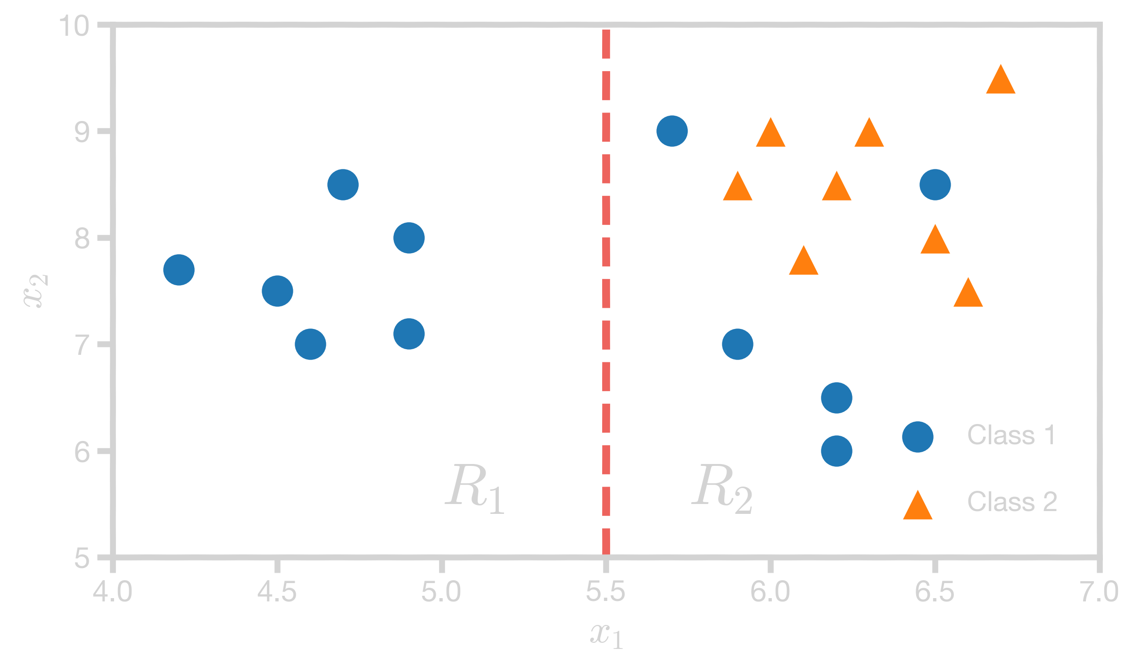





Classification Error
Consider region $R_{2}$:
$$Classification error= \frac{error}{total}$$
$$=\frac{Number of minority class data points }{Total number of data points}$$
$$=\frac{Number of }{Total number of data points}$$
$$=1 − \frac{Number of majority data points }{Total number of data points}$$

Slide 40

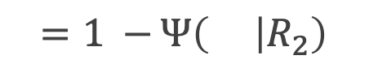
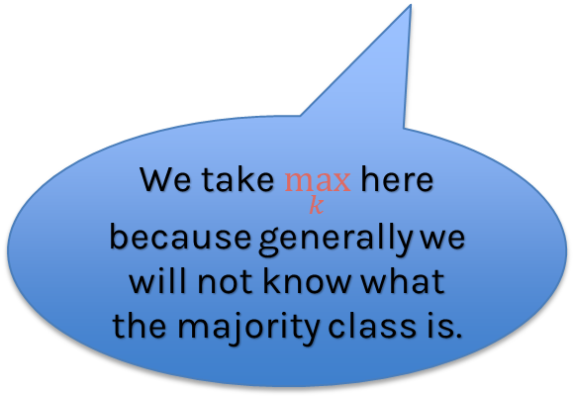

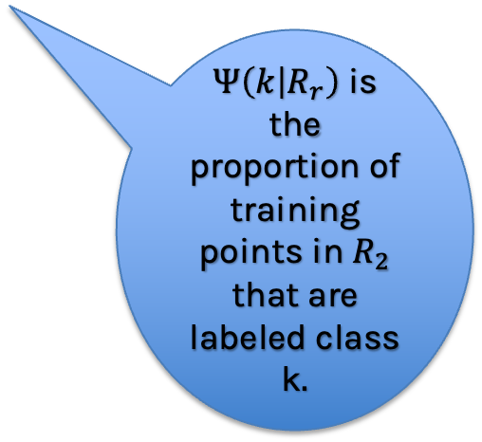

Classification Error
Classification error in region $R_{2}$:
$$=1 − \frac{Number of majority data points }{Total number of data points}$$
$$=1 −⁡Ψ\left( | R_{2}\right)$$
=$1 −\max_{k}{(Ψ\left(k | R_{r}\right)) }⁡$
$Ψ\left(k | R_{r}\right)$is the proportion of training points in $R_{2}$ that are labeled class k$.$
We take $\max_{k}$here because generally we will not know what the majority class is.

Slide 41



Classification Error
 |  |  | $$Error = 1 −\max_{k}{(Ψ\left(k | R_{r}\right)) }⁡$$
$$R_{1}$$ | 6 | 0
$$R_{2}$$ | 5 | 8
$$1 −\max\left(\frac{6}{6} , \frac{0}{6}\right)=0$$
$$1 −\max\left(\frac{5}{13} , \frac{8}{13}\right)=\frac{5}{13}=0.38$$

Slide 42

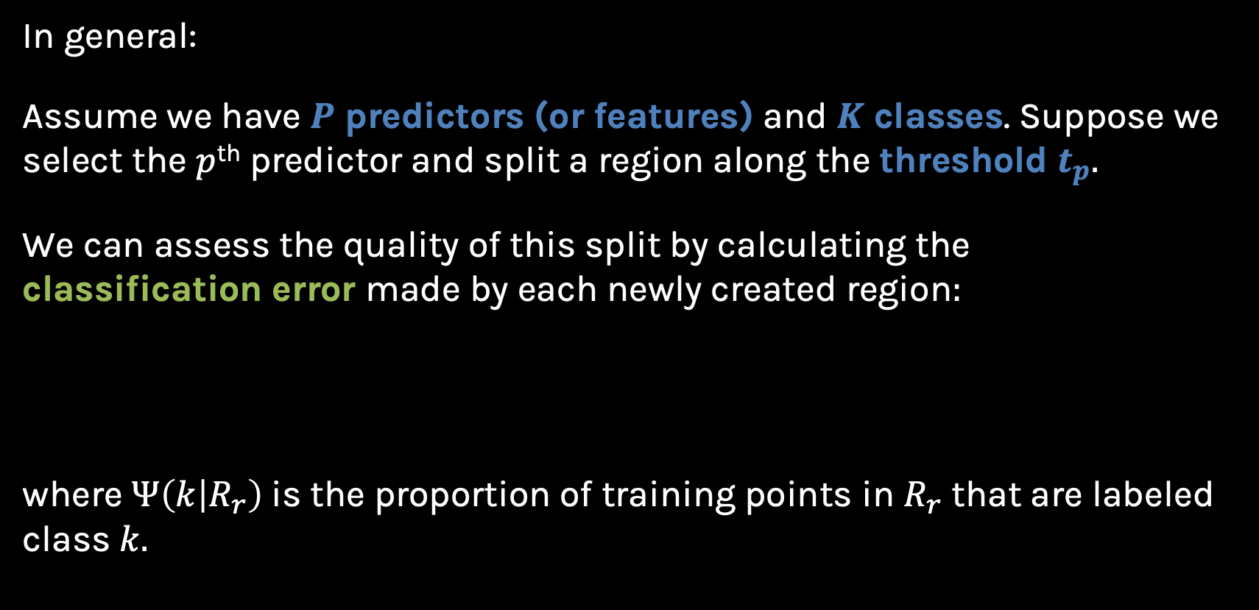
Classification Error
In general:
Assume we have $P$ predictors (or features) and $K$ classes. Suppose we select the $p$^{th} predictor and split a region along the threshold $t_{p}.$
We can assess the quality of this split by calculating the classification error made by each newly created region$:$
where $Ψ\left(k | R_{r}\right)$is the proportion of training points in $R_{r}$ that are labeled class $k.$
$$Error \left(R_{r}\right| p, t_{p})=1 −\max_{k}{(Ψ\left(k | R_{r}\right)) }⁡$$

Slide 43
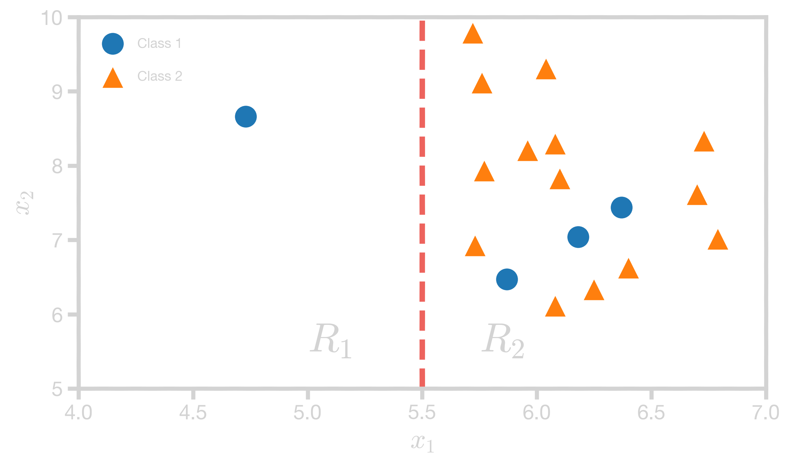


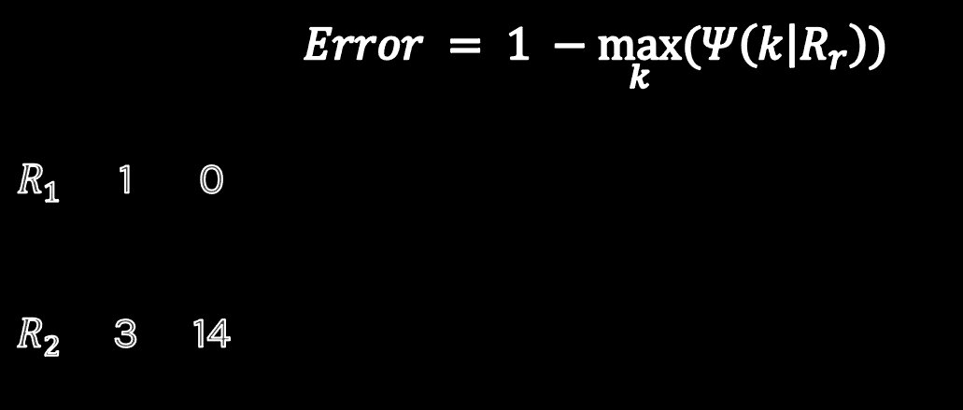

Classification Error
Now calculate the error for the following split:
 |  |  | $$Error = 1 −\max_{k}{(Ψ\left(k | R_{r}\right)) }⁡$$
$$R_{1}$$ | 1 | 0
$$R_{2}$$ | 3 | 14
$$1 −\max\left(\frac{1}{1} , \frac{0}{1}\right)=0$$
$$1 −\max\left(\frac{3}{17} , \frac{14}{17}\right)=\frac{3}{17}=0.18$$
$R_{1}$ has a smaller error that $R_{2}$. Does that mean this is a good split?

Slide 44


Classification Error
We need to take the weighted average over both regions so the number of points in each region is taken into consideration:
$$\min_{p, { t}_{p}}\left[\frac{N_{1}}{N}Error\left(R_{1} | p , t_{p}\right)+\frac{N_{2}}{N}Error\left(R_{2} | p , t_{p}\right)\right]$$
where $N_{r}$is the number of training points inside region $R_{r}$.
Notes:
Add more points

Slide 45

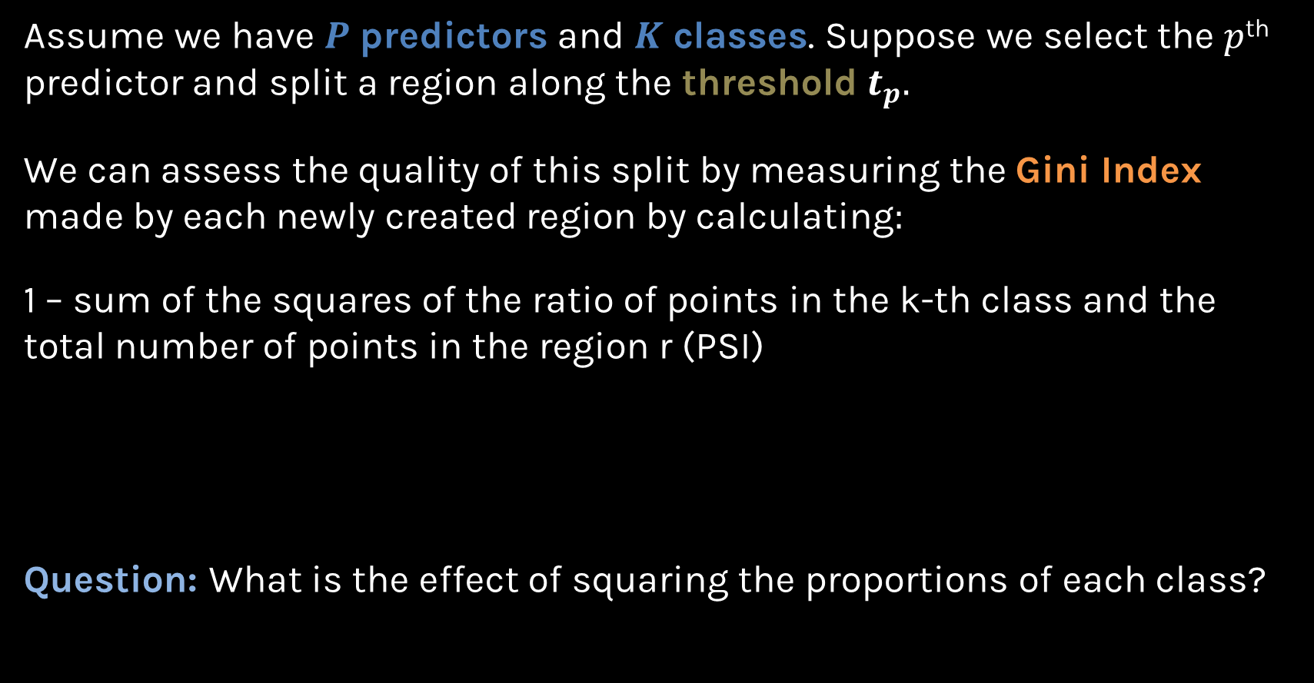
Gini Index
Assume we have $P$ predictors and $K$ classes. Suppose we select the $p$^{th} predictor and split a region along the threshold $t_{p}.$
We can assess the quality of this split by measuring the Gini Index made by each newly created region by calculating$:$
1 – sum of the squares of the ratio of points in the k-th class and the total number of points in the region r (PSI)
Question: What is the effect of squaring the proportions of each class?
$$Gini \left(R_{r}\right| p, t_{p})=1 −\sum_{k}{{Ψ(k|R_{r})}^{2}}⁡$$

Slide 46

Quiz time
Which of the following statements best describes the effect of squaring the proportions of each class when calculating the Gini Index?
Options:
Squaring the proportions magnifies the influence of majority classes in a region, thereby overstating their significance.
The squaring process accentuates the contrast between pure regions and mixed ones, enabling the index to better differentiate between quality splits.
The act of squaring diminishes the index's sensitivity to minor fluctuations in class distributions, making it more stable.
Squaring the proportions directly correlates the Gini Index with the count of predictors 𝑷, biasing the selection of split predictors.

Slide 47
Quiz time
Which of the following statements best describes the effect of squaring the proportions of each class when calculating the Gini Index?
Options:
Squaring the proportions magnifies the influence of majority classes in a region, thereby overstating their significance.
The squaring process accentuates the contrast between pure regions and mixed ones, enabling the index to better differentiate between quality splits.
The act of squaring diminishes the index's sensitivity to minor fluctuations in class distributions, making it more stable.
Squaring the proportions directly correlates the Gini Index with the count of predictors 𝑷, biasing the selection of split predictors.

Slide 48
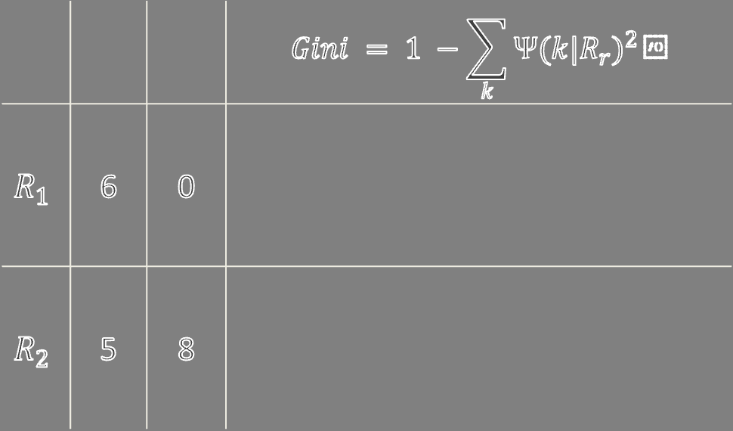


Gini Index
 |  |  | $$Gini = 1 −\sum_{k}{{Ψ(k|R_{r})}^{2}}⁡$$
$$R_{1}$$ | 6 | 0
$$R_{2}$$ | 5 | 8
$$1 −\left[{\left(\frac{6}{6}\right)}^{2}+{\left(\frac{0}{6}\right)}^{2}\right]{=0 }$$
$$1 −\left[{\left(\frac{5}{13}\right)}^{2}+{\left(\frac{8}{13}\right)}^{2}\right]{=\frac{80}{169}}=0.47$$
Compared to 0.38 when we used classification error

Slide 49
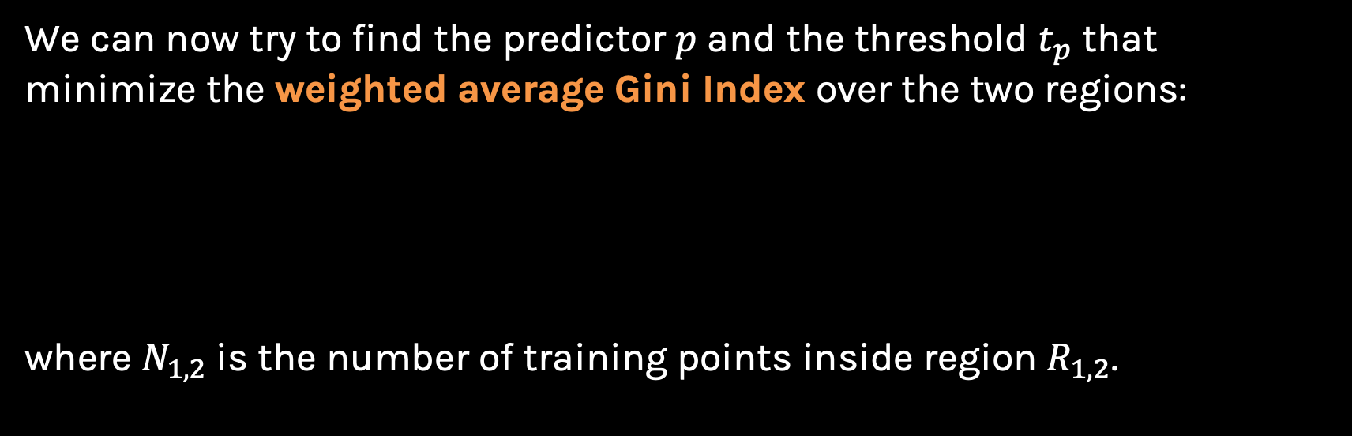

Gini Index
We can now try to find the predictor $p$ and the threshold $t_{p}$ that minimize the weighted average Gini Index over the two regions:
where $N_{1,2}$is the number of training points inside region $R_{1,2}$.
$$\min_{p, t_{p}}\left[\frac{N_{1}}{N}Gini\left(R_{1} | p , t_{p}\right)+\frac{N_{2}}{N}Gini\left(R_{2} | p , t_{p}\right)\right]$$

Slide 50
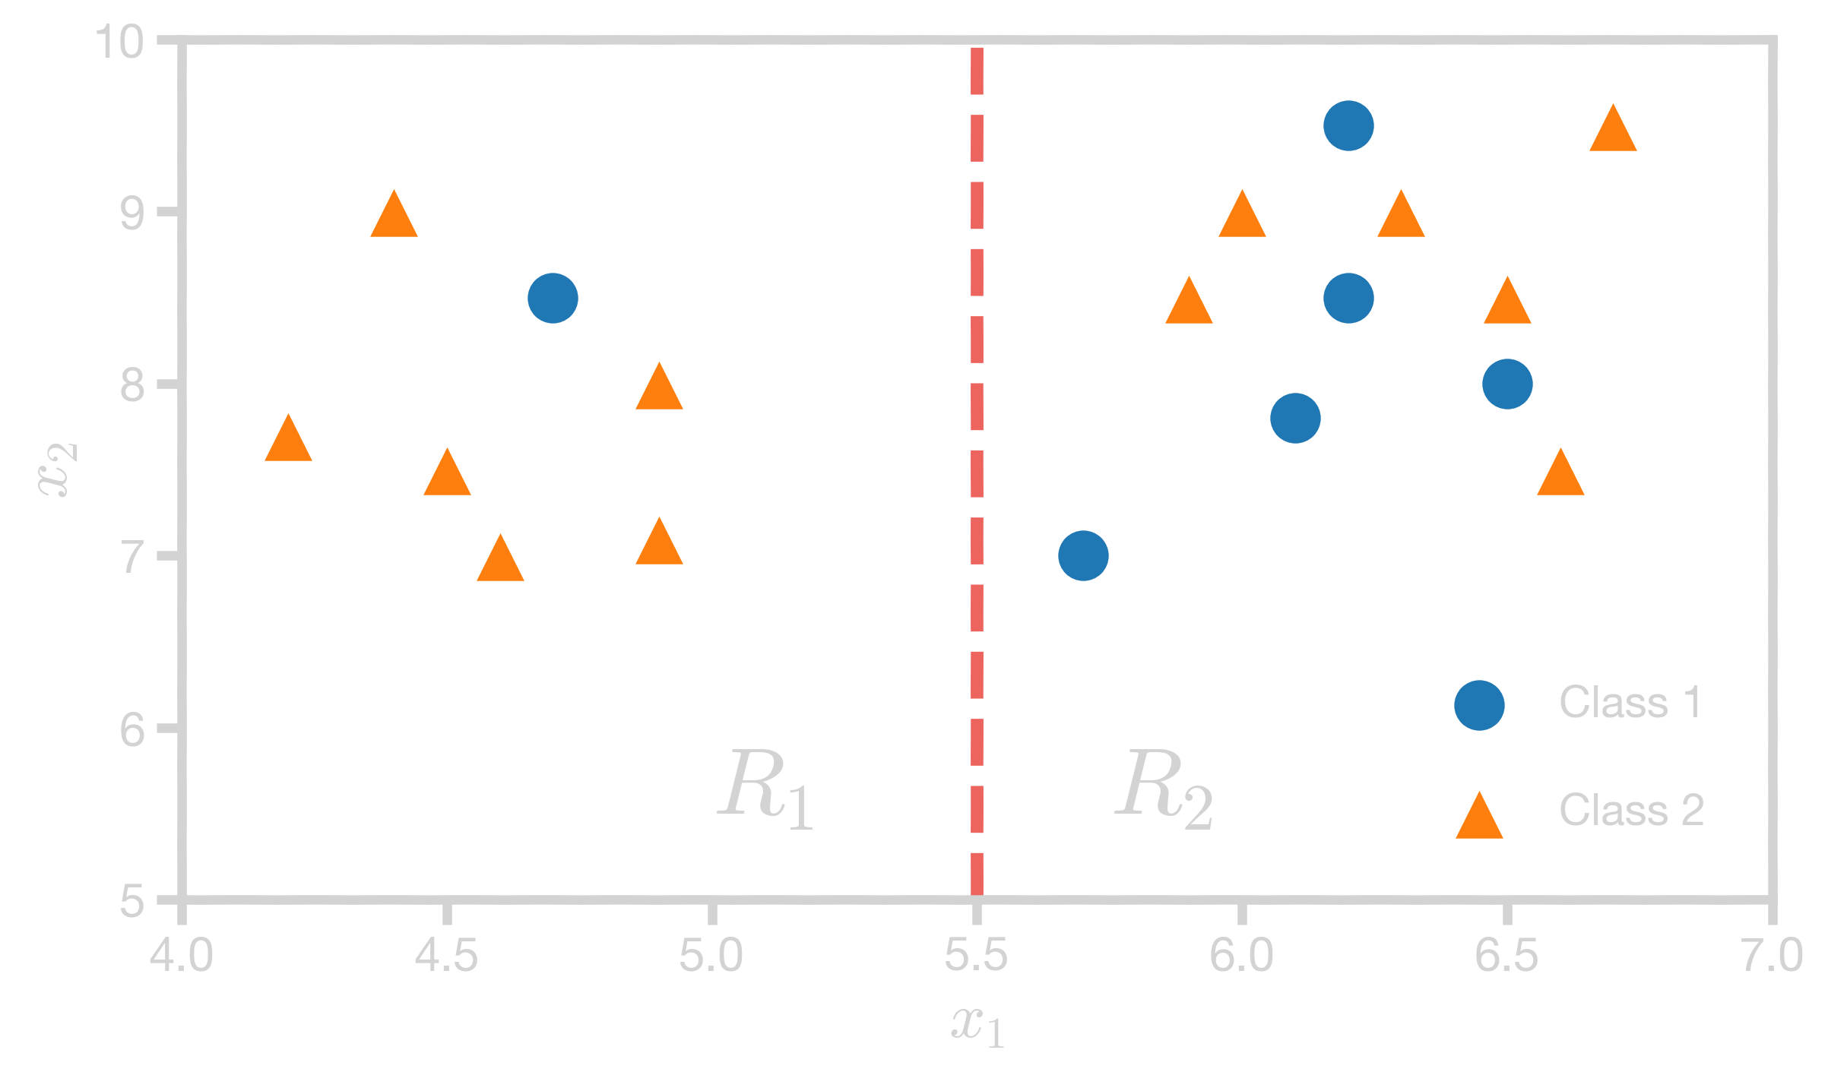
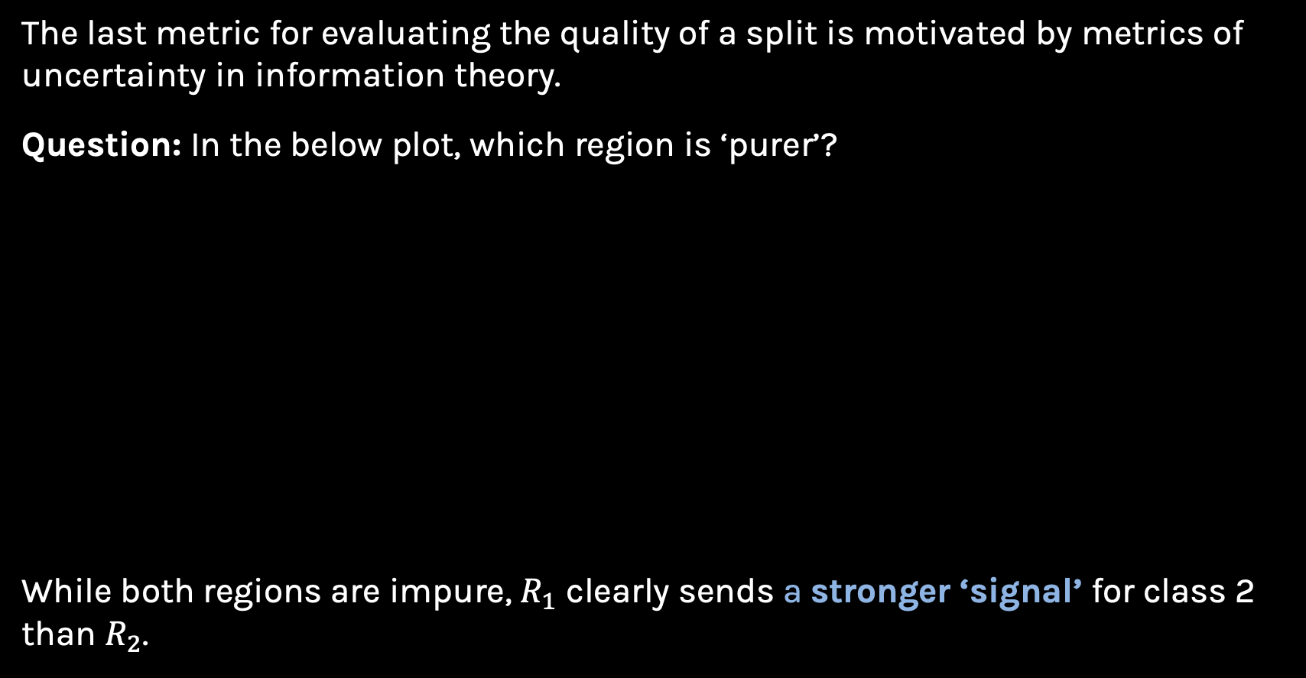
Information Theory
The last metric for evaluating the quality of a split is motivated by metrics of uncertainty in information theory.
Question: In the below plot, which region is ‘purer’?
While both regions are impure, $R_{1}$ clearly sends a stronger ‘signal’ for class 2 than $R_{2}$.

Slide 51

Information Theory
One way to quantify the strength of a signal in a particular region is to analyze the distribution of classes within the region. We compute the entropy of this distribution.
For a random variable with a discrete distribution, the entropy is computed by:
$$H\left(x\right)=−\sum_{xεX}{Ψ(x)\log_{2}{Ψ(x)}}⁡$$

Slide 52
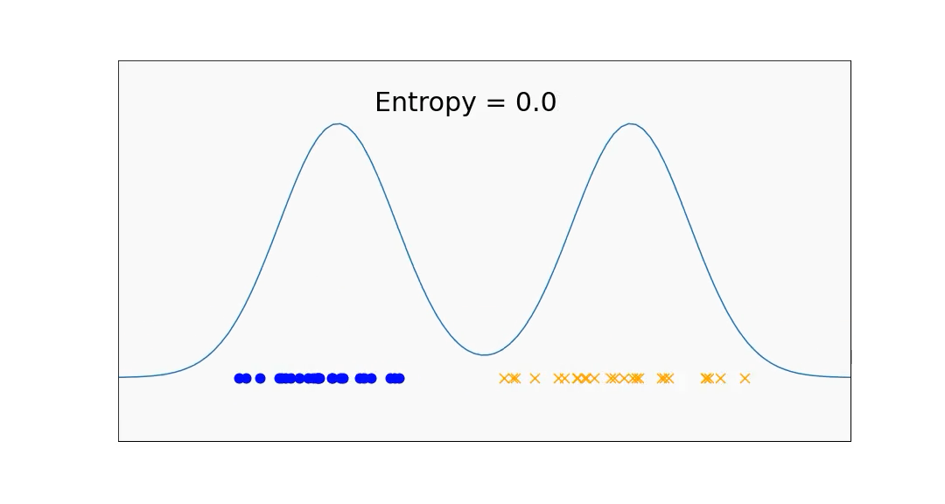

Information Theory
$$H\left(x\right)=−\sum_{xεX}{Ψ(x)\log_{2}{Ψ(x)}}⁡$$
Notes:
Higher Entropy -> Values sampled from it are ‘less predictable’
Lower Entropy -> Values sampled from it are ‘more predictable’

Slide 53
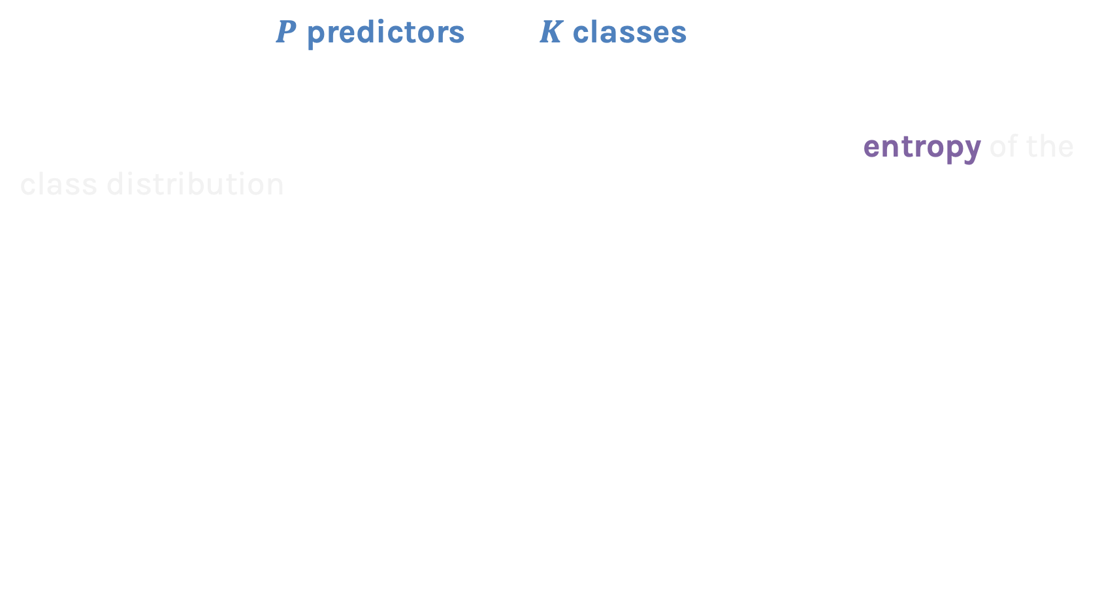

Entropy
Assume we have $P$ predictors and $K$ classes. Suppose we select the $p$^{th} predictor and split a region along the threshold $t_{p}.$
We can assess the quality of this split by measuring the entropy of the class distribution in each newly created region by calculating$:$
Note: We are actually computing the conditional entropy of the distribution of training points amongst the $K$ classes given that the point is in region $r$.
$$Entropy \left(R_{r}\right| p, { t}_{p})= −\sum_{k}{Ψ(k|R_{r})\log_{2}{Ψ(k|R_{r})}}⁡$$

Slide 54
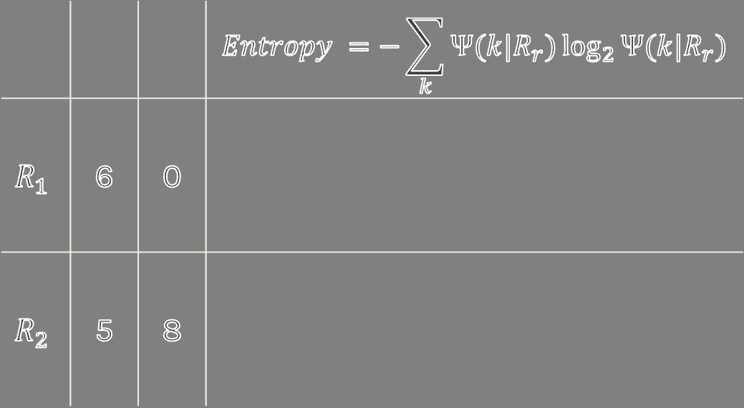


Entropy
 |  |  | $$Entropy =−\sum_{k}{Ψ(k|R_{r})\log_{2}{Ψ(k|R_{r})}}$$
$$R_{1}$$ | 6 | 0
$$R_{2}$$ | 5 | 8
$$−\left[\frac{6}{6}\log_{2}{\frac{6}{6}}+\frac{0}{6}\log_{2}{\frac{0}{6}}\right]{=0 }$$
$$−\left[\frac{5}{13}\log_{2}{\frac{5}{13}}+\frac{8}{13}\log_{2}{\frac{8}{13}}\right]{≈\text{1.38} }$$

Slide 55
Entropy
Error Measurement | Value
Classification Error | 0.38
Gini Index | 0.47
Entropy | 1.38

Slide 56
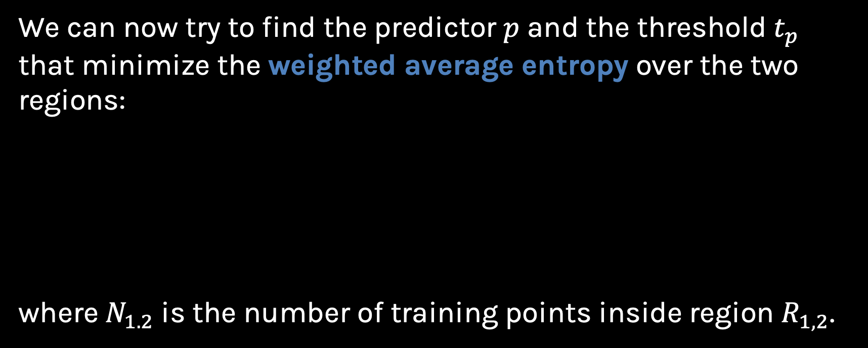

Entropy
We can now try to find the predictor $p$ and the threshold $t_{p}$ that minimize the weighted average entropy over the two regions:
where $N_{1.2}$is the number of training points inside region $R_{1,2}$.
$$\min_{p, t_{p}}\left[\frac{N_{1}}{N}Entropy\left(R_{1} | p , t_{p}\right)+\frac{N_{2}}{N}Entropy\left(R_{2} | p , t_{p}\right)\right]$$

Slide 57
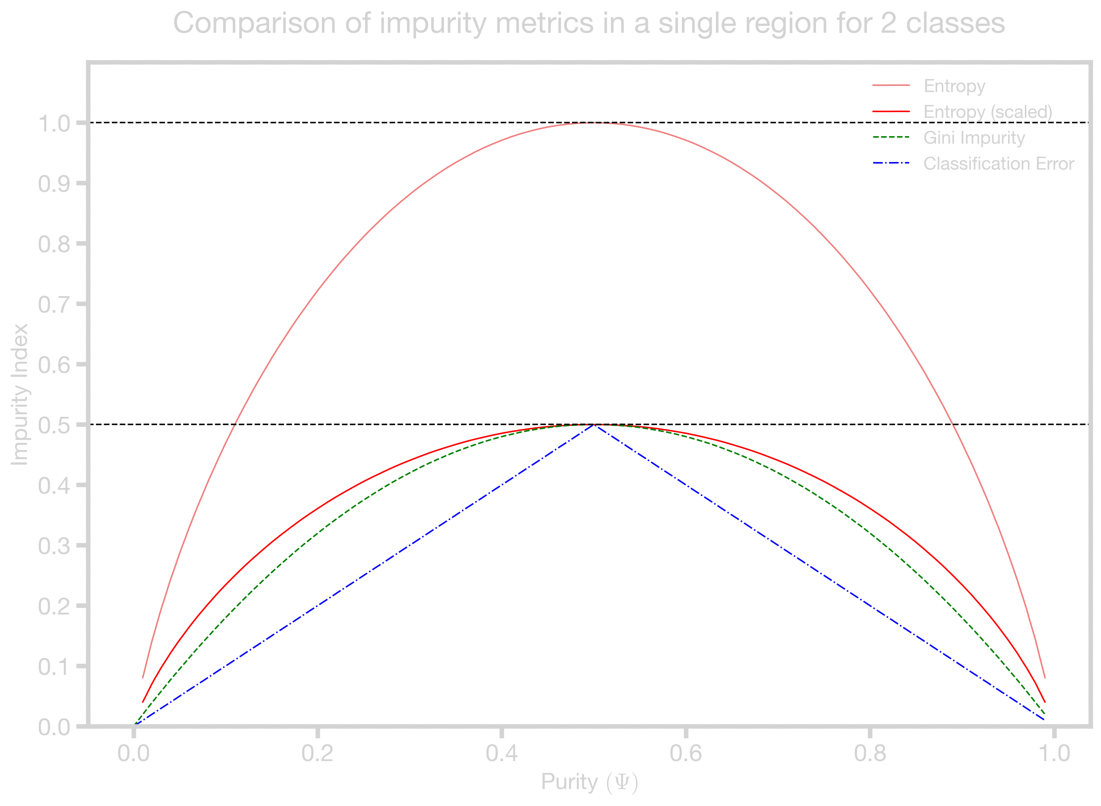
Comparison of Criteria
Question: Which of the three criteria fits our guideline the best?
Note: Sklearn uses the unscaled entropy as a splitting criterion

Slide 58
Comparison of Criteria
Question: Which of the three criteria fits our guideline the best?
Entropy penalizes impurity the most

Slide 59
Learning the Model
Learning the ‘optimal’ decision tree for any given set of data is NP complete (intractable) for numerous simple definitions of ‘optimal’. Instead, we will use a greedy algorithm.
Start with an empty decision tree (undivided feature space)
Choose the ‘optimal’ predictor on which to split and choose the ‘optimal’ threshold value for splitting.
Recurse on each new node until the stopping condition is met.
For the case of classification, predict each region to have a class label based on the largest class of the training points in that region (majority class).
Recurse on each new node until the stopping condition is met.

Slide 60
Learning the Model
Recurse on each new node until the stopping condition is met.

Slide 61
Outline
Motivation
Decision Trees – Classification
Intuition
Predictions
Splitting Criteria
Stopping Conditions
Decision Trees - Regression

Slide 62


Slide 63
Stopping Conditions
Question: If we don’t terminate the decision tree algorithm manually, what will the leaf nodes of the decision tree look like?
The tree will continue to grow until each region contains exactly one training point and the model attains 100% training accuracy.

Slide 64

Stopping Conditions
Question: How can we prevent this from happening?

Slide 65
Stopping Conditions
The most common stopping condition is to limit the maximum depth (max_depth) of the tree.
Depth = 1
max_depth = 1

Slide 66
Stopping Conditions
The most common stopping condition is to limit the maximum depth (max_depth) of the tree.
Depth = 1
max_depth = 2
Depth = 2

Slide 67
Stopping Conditions
The most common stopping condition is to limit the maximum depth (max_depth) of the tree.
Depth = 1
max_depth = 3
Depth = 2
Depth = 3

Slide 68
Stopping Conditions
Other common simple stopping conditions are:
Don’t split a region if all instances in the region belong to the same class.
Pure leaf Nodes

Slide 69
Stopping Conditions
Other common simple stopping conditions are:
Don’t split a region if the number of instances in any of the sub-regions will fall below pre-defined threshold (min_samples_leaf).
min_samples_leaf = 4

Slide 70
Stopping Conditions
Other common simple stopping conditions are:
Don’t split a region if the total number of leaves in the tree will exceed a pre-defined threshold (max_leaf_nodes).
max_leaf_nodes = 3
Do you see any issue with this?
3 leaf Nodes

Slide 71

Stopping Conditions
Normally, Sklearn grows trees in what is called ‘level-order’-fashion until a stopping condition such as max_depth is met.
However, if a value for max_leaf_nodes is specified, Sklearn will instead grow the tree in a ‘best-first’ fashion.
But what do level-order and best-first growth mean?
level-order
best-first

Slide 72
Stopping Conditions
Normally, Sklearn grows trees in what is called ‘level-order’-fashion until a stopping condition such as max_depth is met.
However, if a value for max_leaf_nodes is specified, Sklearn will instead grow the tree in a ‘best-first’ fashion.
But what do level-order and best-first growth mean?
level-order
best-first
Level-order is also sometimes called ‘breadth-first’-search but we will use the term ‘level-order’ so it won’t be confused with the similar sounding ‘best-first’ search.

Slide 73
Example 1: Level-Order
Consider the following decision tree with max_depth=2 that predicts if a person has heart disease based on age, sex, BP and cholesterol:
Gini = 0.494
Samples = 270
Class = No Disease
Notes:
The tree is grown in the order of the animation, calculating the weighted impurity to find the best predictor and threshold at each split.

Slide 74
Example 1: Level-Order
Consider the following decision tree with max_depth=2 that predicts if a person has heart disease based on age, sex, BP and cholesterol:
Sex <= 0.5
Gini = 0.494
Samples = 270
Class = No Disease
Gini = 0.354
Samples = 87
Class = No Disease
BP <= 143.5
Gini = 0.354
Samples = 87
Class = No Disease
Gini = 0.496
Samples = 183
Class = Disease
Age <= 53.5
Gini = 0.496
Samples = 183
Class = Disease
Gini = 0.233
Samples = 67
Class = No Disease
Gini = 0.495
Samples = 20
Class = Disease
Gini = 0.474
Samples = 83
Class = No Disease
Gini = 0.435
Samples = 100
Class = Disease
Notes:
The tree is grown in the order of the animation, calculating the weighted impurity to find the best predictor and threshold at each split.

Slide 75
Example 1: Best-first growth
Sklearn determines the best split based on impurity decrease. The resulting tree will be the same when fully grown, just the order in which it is built is different.
Gini = 0.494
Samples = 270
Class = No Disease
Notes:
The tree is grown in the order of the animation, calculating the weighted impurity to find the best predictor and threshold at each split.

Slide 76
Example 1: Best-first growth
Sklearn determines the best split based on impurity decrease. The resulting tree will be the same when fully grown, just the order in which it is built is different.
Sex <= 0.5
Gini = 0.494
Samples = 270
Class = No Disease
Gini = 0.354
Samples = 87
Class = No Disease
Gini = 0.496
Samples = 183
Class = Disease
BP <= 143.5
Gini = 0.354
Samples = 87
Class = No Disease
Gini = 0.233
Samples = 67
Class = No Disease
Gini = 0.495
Samples = 20
Class = Disease
Impurity Decrease = $\frac{87}{270}\left[0.354 − \frac{67}{87}.0.233− \frac{20}{87}.0.495\right]≈0.0195$

Slide 77


Example 1: Best-first growth
Sex <= 0.5
Gini = 0.494
Samples = 270
Class = No Disease
Age <= 53.5
Gini = 0.496
Samples = 183
Class = Disease
Gini = 0.354
Samples = 87
Class = No Disease
Gini = 0.496
Samples = 183
Class = Disease
BP <= 143.5
Gini = 0.354
Samples = 87
Class = No Disease
Impurity Decrease $≈0.35$
Gini = 0.233
Samples = 67
Class = No Disease
Gini = 0.495
Samples = 20
Class = Disease
Gini = 0.474
Samples = 83
Class = No Disease
Gini = 0.435
Samples = 100
Class = Disease
Impurity Decrease $≈0.019$

Slide 78
Example 1: Best-first growth
Sex <= 0.5
Gini = 0.494
Samples = 270
Class = No Disease
Age <= 53.5
Gini = 0.496
Samples = 183
Class = Disease
Gini = 0.354
Samples = 87
Class = No Disease
Gini = 0.496
Samples = 183
Class = Disease
Gini = 0.474
Samples = 83
Class = No Disease
Gini = 0.435
Samples = 100
Class = Disease
This process is repeated until max_leaf_nodes is reached.
Now we compare the impurity decrease when splitting these 3 nodes!
Notes:
Goes on and on

Slide 79
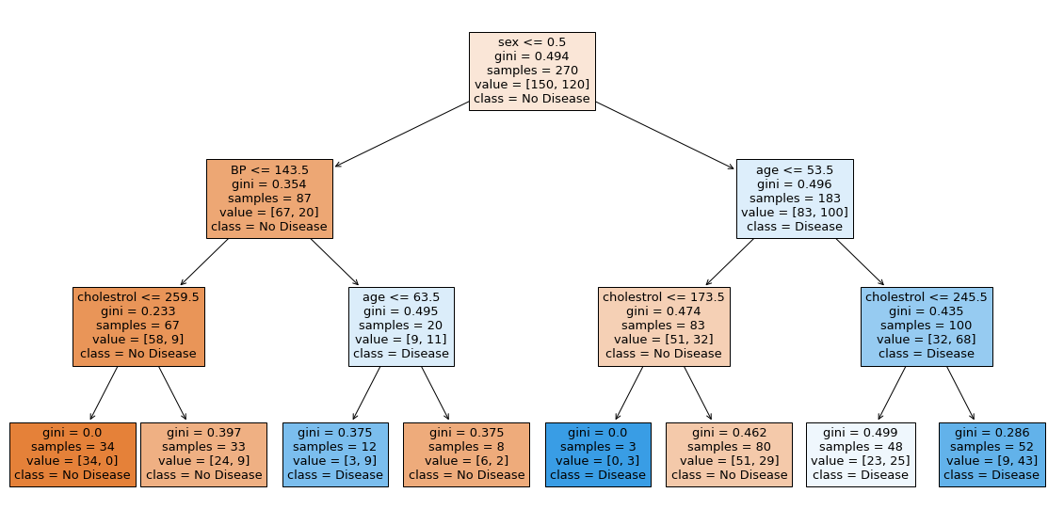
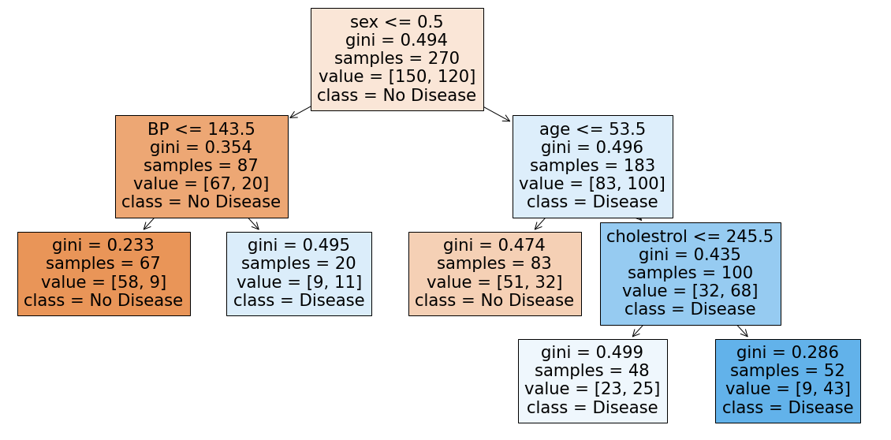
Example 2: Level-order vs Best-first growth
max_depth = 3
max_leaf_nodes = 5
Notes:
Put max depth and max leaf nodes = 5

Slide 80

Stopping Conditions
A more restrictive stopping condition is:
Compute the gain in purity of splitting a region R into R₁ and R₂:
$Gain\left(R\right)=Δ\left(R\right)=m\left(R\right)−\frac{N_{1}}{N}m\left(R_{1}\right)−\frac{N_{2}}{N}m(R_{2})$
Don’t split if the gain is less than some pre-defined threshold (min_impurity_decrease).
Classification Error/Gini Index/Entropy

Slide 81

How do we decide what is the appropriate stopping condition or stopping method?

Slide 82
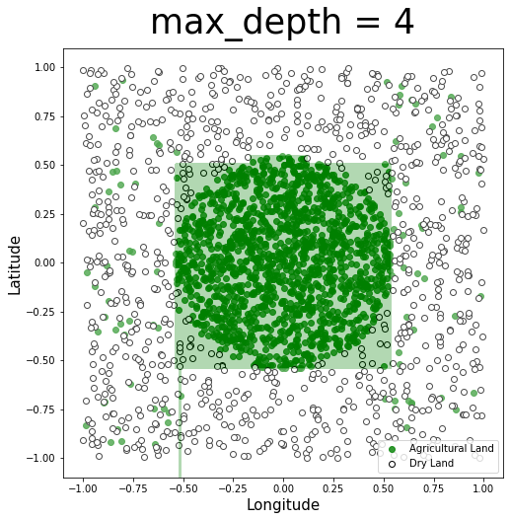
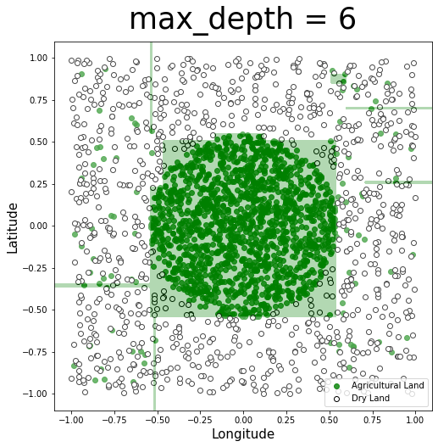
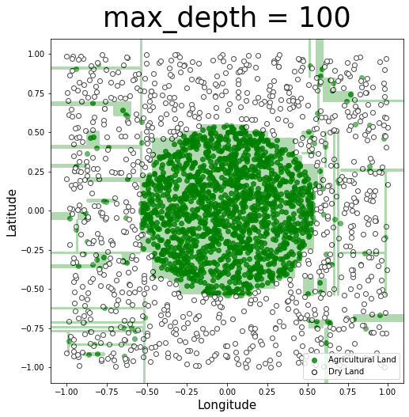
Variance vs Bias
. . . .

Slide 83
Variance vs Bias
. . . .
Bias decreases (can overfit)

Slide 84
Variance vs Bias
. . . .
Bias decreases (can overfit)
Variance decreases (can underfit)
Complex trees are also harder to interpret and more computationally expensive to train.

Slide 85
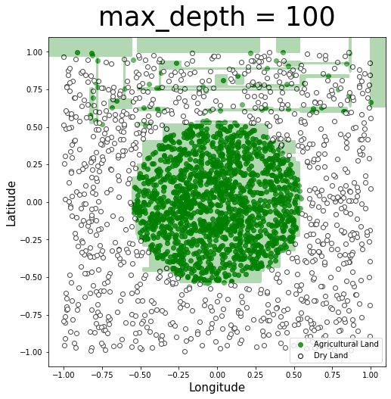
Variance vs Bias
High Bias: Trees of low depth are not a good fit for the training data - it’s unable to capture the nonlinear boundary separating the two classes.
Low Variance: Trees of low depth are robust to slight perturbations in the training data - the square carved out by the model is stable if you move the boundary points a bit.
Low Bias: With a high depth, we can obtain a model that correctly classifies all points on the boundary (by zig-zagging around each point).

Slide 86
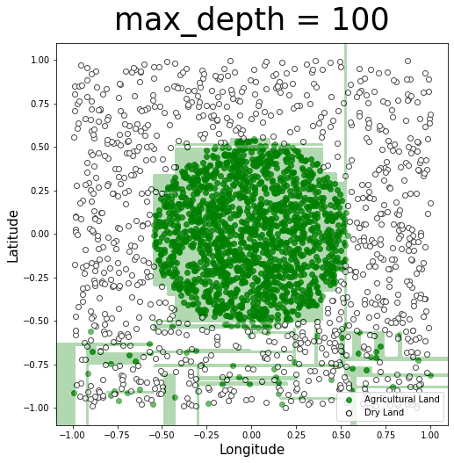
Variance vs Bias
High Bias: Trees of low depth are not a good fit for the training data - it’s unable to capture the nonlinear boundary separating the two classes.
Low Variance: Trees of low depth are robust to slight perturbations in the training data - the square carved out by the model is stable if you move the boundary points a bit.
Low Bias: With a high depth, we can obtain a model that correctly classifies all points on the boundary (by zig-zagging around each point).

Slide 87
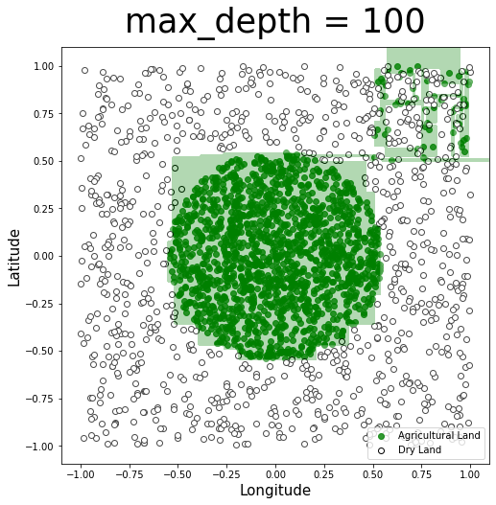
Variance vs Bias
High Bias: Trees of low depth are not a good fit for the training data - it’s unable to capture the nonlinear boundary separating the two classes.
Low Variance: Trees of low depth are robust to slight perturbations in the training data - the square carved out by the model is stable if you move the boundary points a bit.
Low Bias: With a high depth, we can obtain a model that correctly classifies all points on the boundary (by zig-zagging around each point).
High Variance: Trees of high depth are sensitive to perturbations in the training data, especially to changes in the boundary points.

Slide 88

Stopping Conditions
max_depth
min_samples_leaf
max_leaf_nodes
min_impurity_decrease
How can we determine the appropriate hyperparameters?
cross-validation

Slide 89
Outline
Motivation
Decision Trees – Classification
Intuition
Predictions
Splitting Criteria
Stopping Conditions
Decision Trees - Regression

Slide 90
Regression Trees
How can this decision tree approach apply to a regression problem (quantitative outcome)?
Questions to consider:
How would you determine any splitting criteria?
What would be a reasonable objective function?
How would you perform prediction in each leaf?

Slide 91
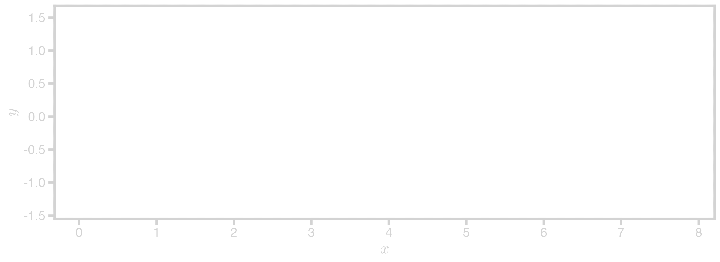
Splitting Criteria
The plot visualizes data points of $\{x,y\}.$By observing patterns, we can identify how and where to make optimal splits. Ideally, each split should lead to groups of data points with more homogeneous values, allowing for better predictions.

Slide 92
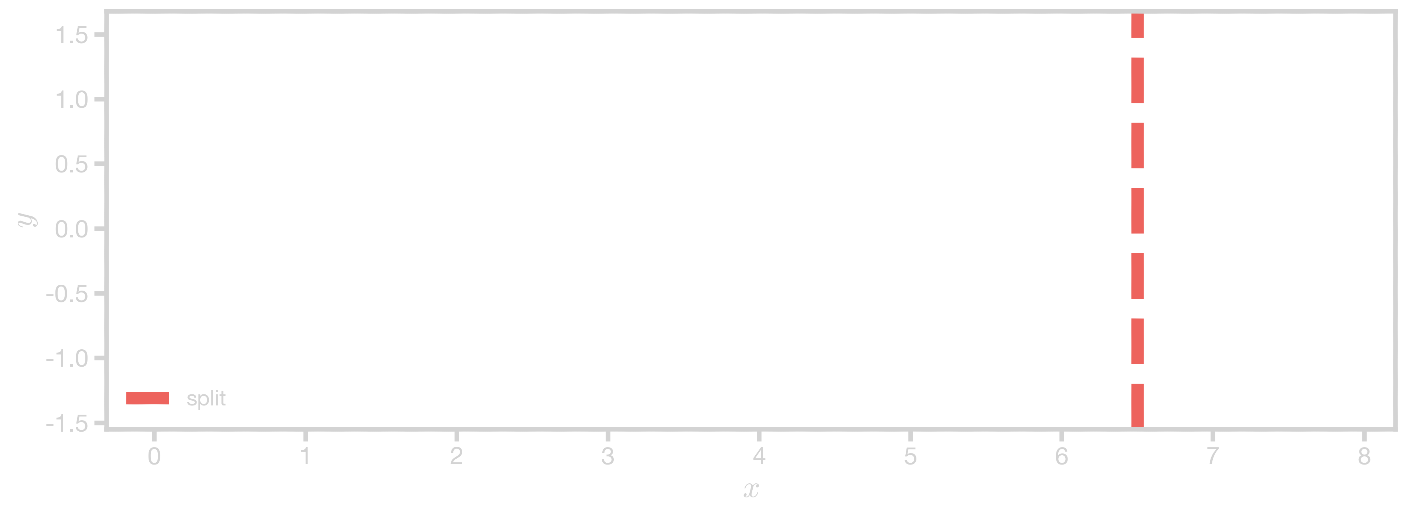
Splitting Criteria
x > 6.5?

Slide 93
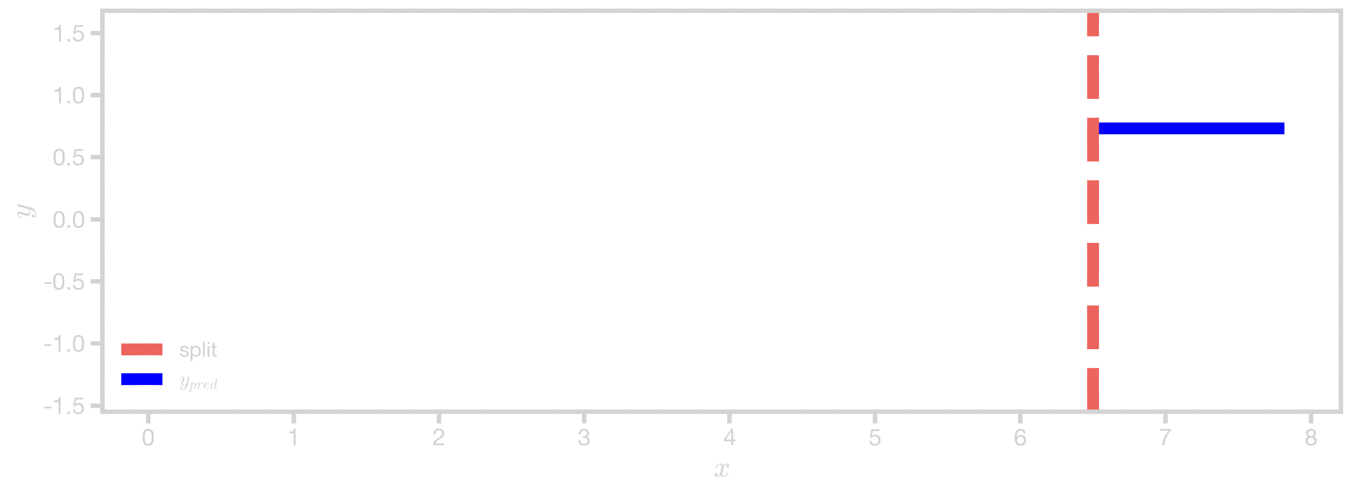
Splitting Criteria
x > 6.5?
Yes
Predict mean (y) = 0.697

Slide 94
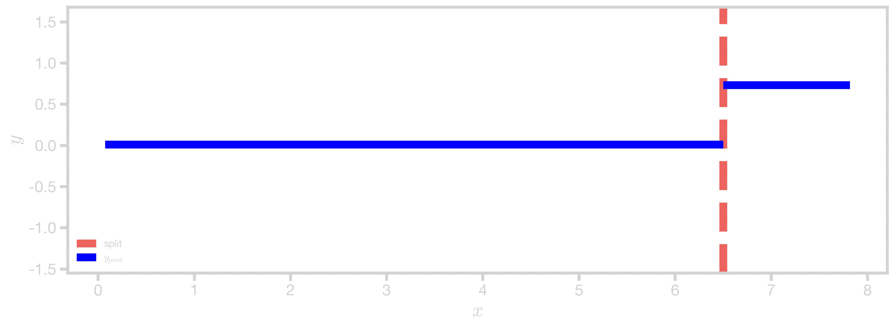
Splitting Criteria
x > 6.5?
No
Yes
Predict mean (y) = -0.008
Predict mean (y) = 0.697

Slide 95
Splitting Criteria
Question: How did we choose the splitting criteria for this regression tree?
x > 6.5?
No
Yes
Predict mean (y) = -0.008
Predict mean (y) = 0.697

Slide 96
Splitting Criteria
We can assess the quality of this split by calculating the mean squared error for each newly created region$:$
$$MSE(R_{1})=\frac{1}{n_{1}}\sum_{i∈R_{1}}{{(y_{i}−{\overline{y}}_{R_{1}})}^{2}}$$
$$MSE(R_{2})=\frac{1}{n_{2}}\sum_{i∈R_{2}}{{(y_{i}−{\overline{y}}_{R_{2}})}^{2}}$$

Slide 97
Splitting Criteria
We can assess the quality of this split by calculating the mean squared error for each newly created region$:$
This is the prediction
$$MSE(R_{r})=\frac{1}{n_{r}}\sum_{i∈R_{wr}}{{(y_{i}−{\overline{y}}_{R_{r}})}^{2}}$$
Note: This is the same as the variance!

Slide 98
Splitting Criteria
When calculating the MSE, we need to consider the number of points in each region. So, we take the weighted average over both regions.
$$\min_{p, { t}_{p}}\left[\frac{N_{1}}{N}MSE(R_{1})+\frac{N_{2}}{N}MSE(R_{2})\right]$$

Slide 99
Splitting Criteria
Question: How did we choose the splitting criteria for this regression tree?
x > 6.5?
No
Yes
Predict mean (y) = -0.008
Predict mean (y) = 0.697

Slide 100
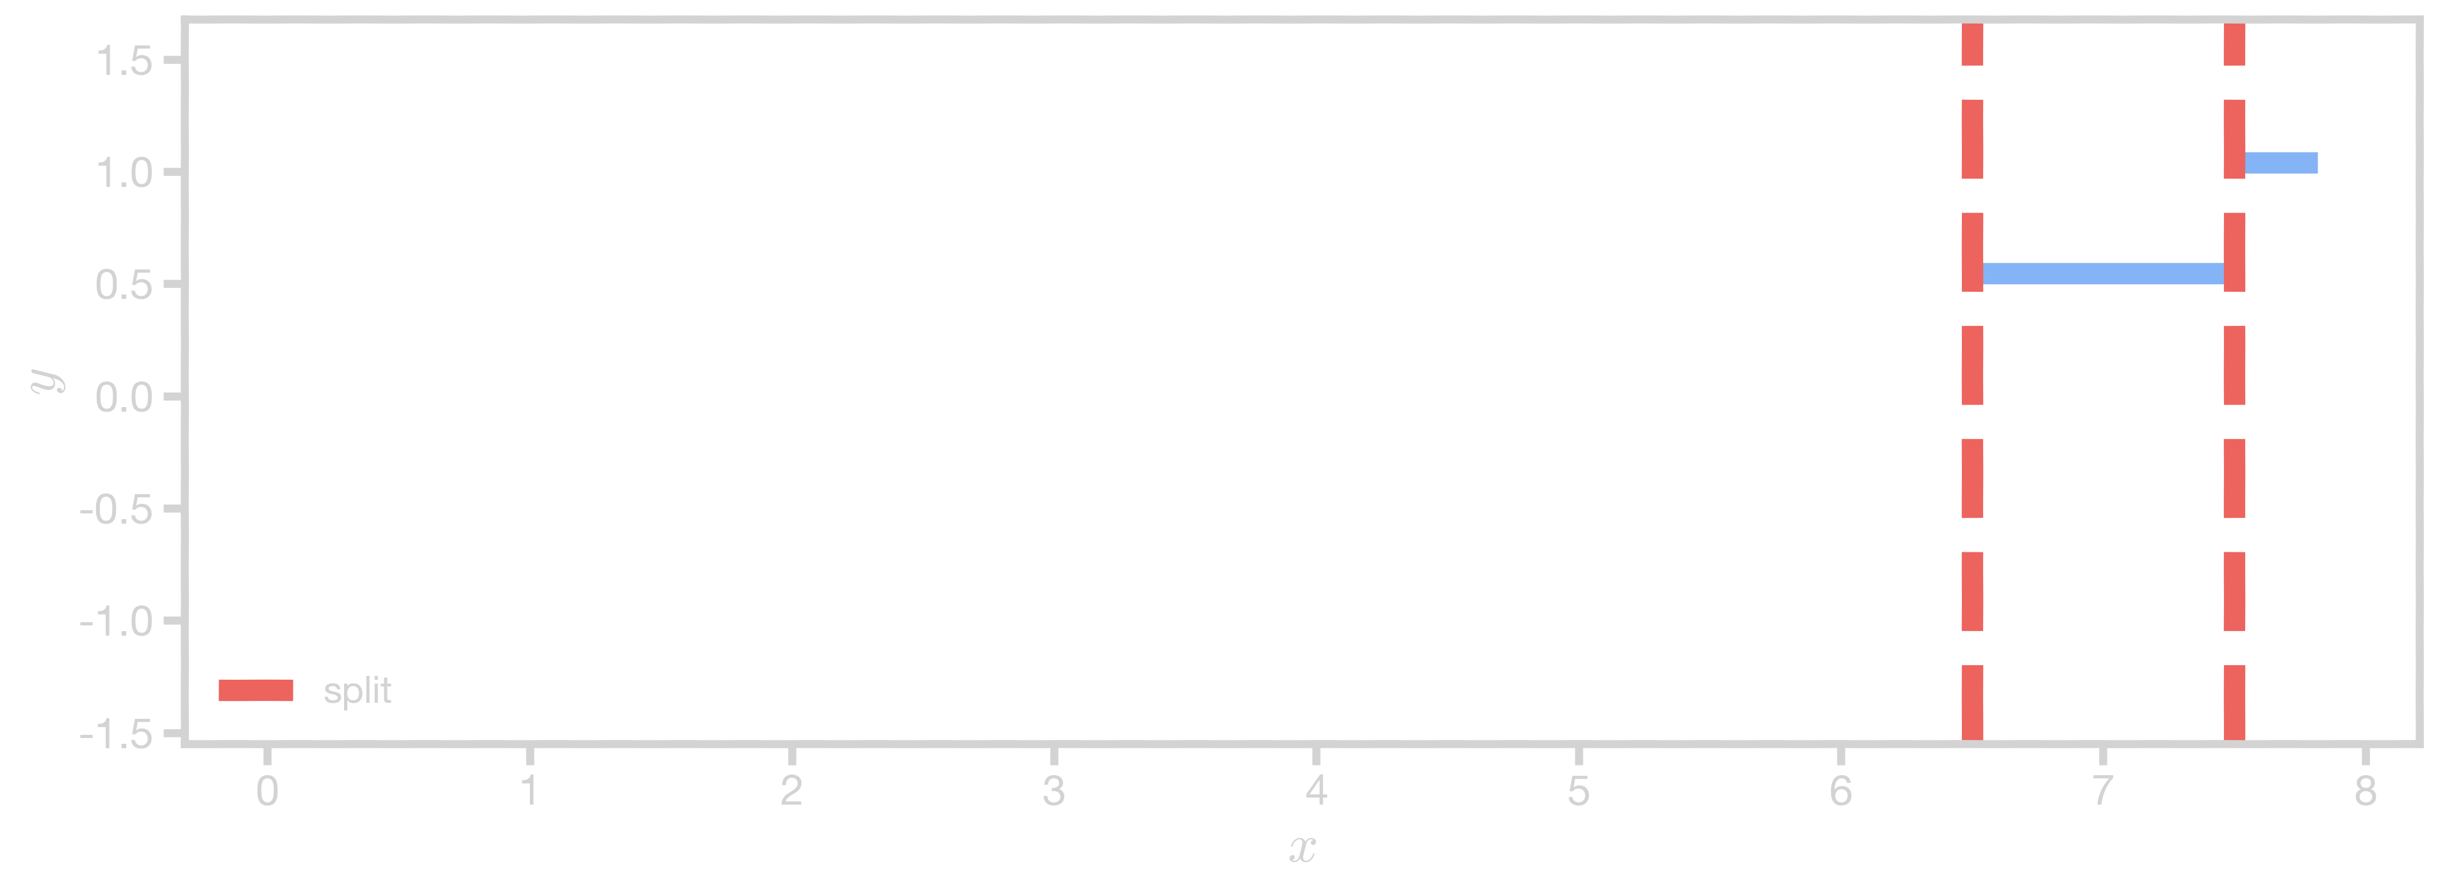
Splitting Criteria
Question: How did we choose the splitting criteria for this regression tree?
x > 6.5?
No
Yes
Predict mean (y) = -0.008
x > 7.5?
No
Yes
Predict mean
Predict mean

Slide 101
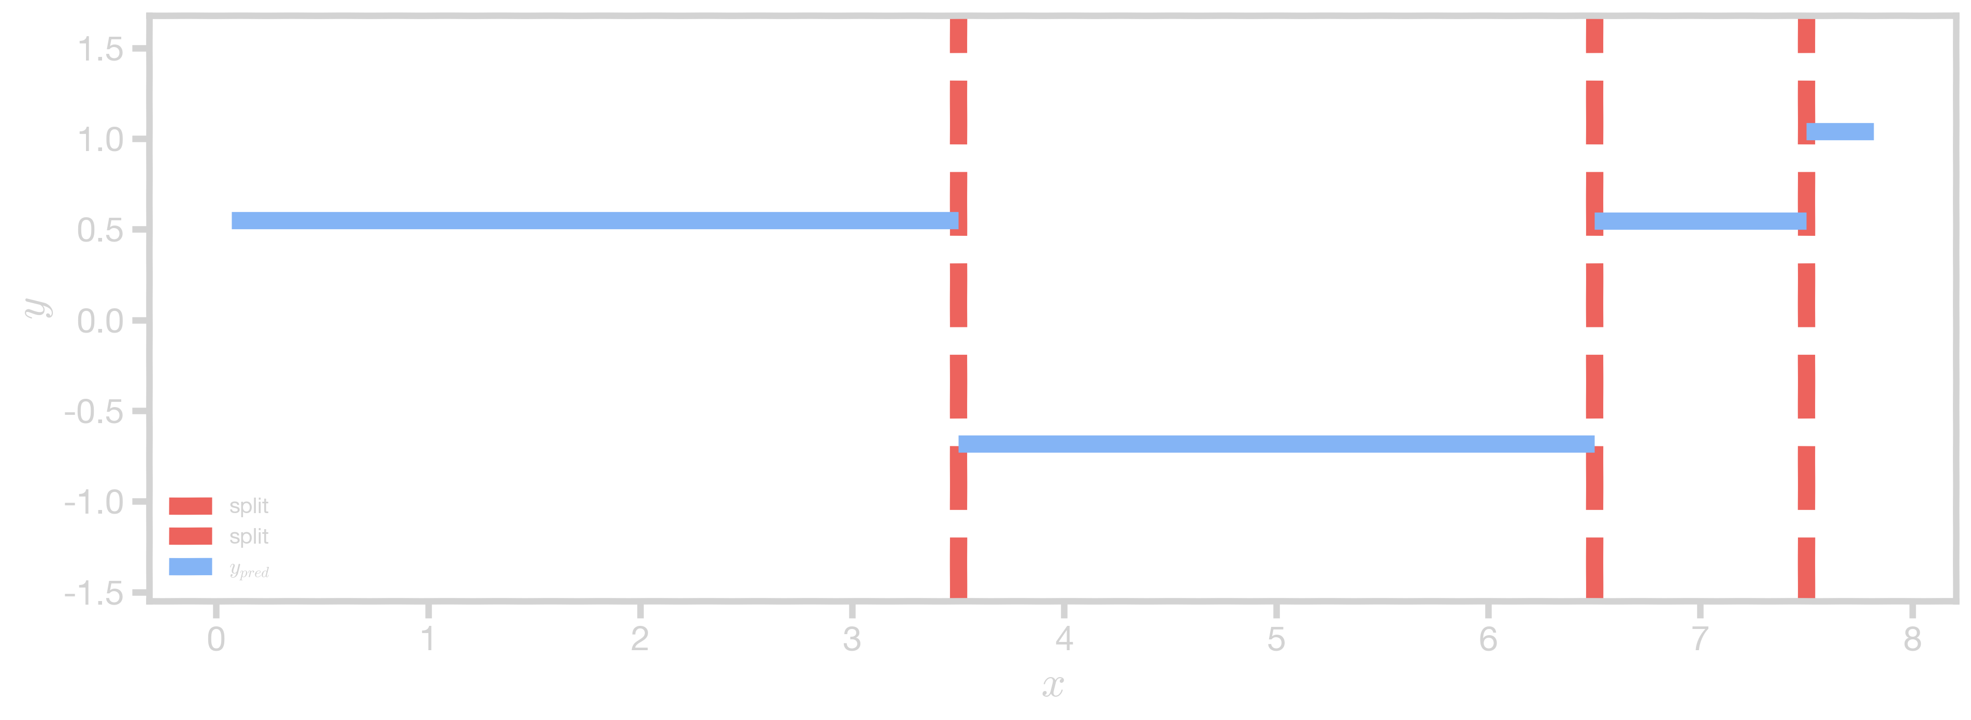
Regression Tree (max_depth = 2)
x > 6.5?
No
Yes
x > 3.5?
x > 7.5?
No
Yes
No
Yes
Predict mean
Predict mean
Predict mean
Predict mean

Slide 102
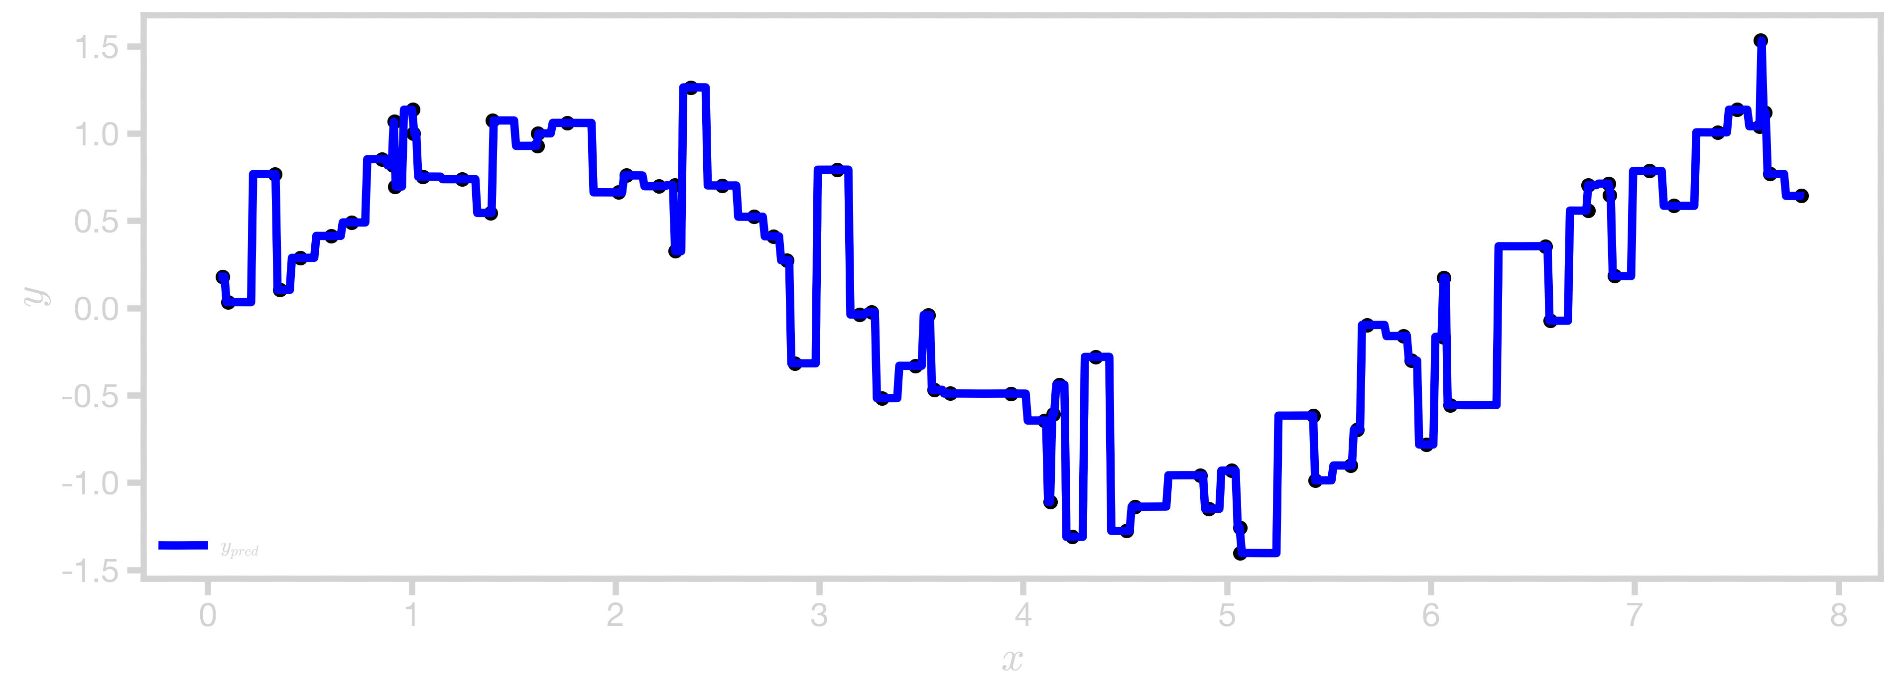
Regression Tree (max_depth = 5)

Slide 103
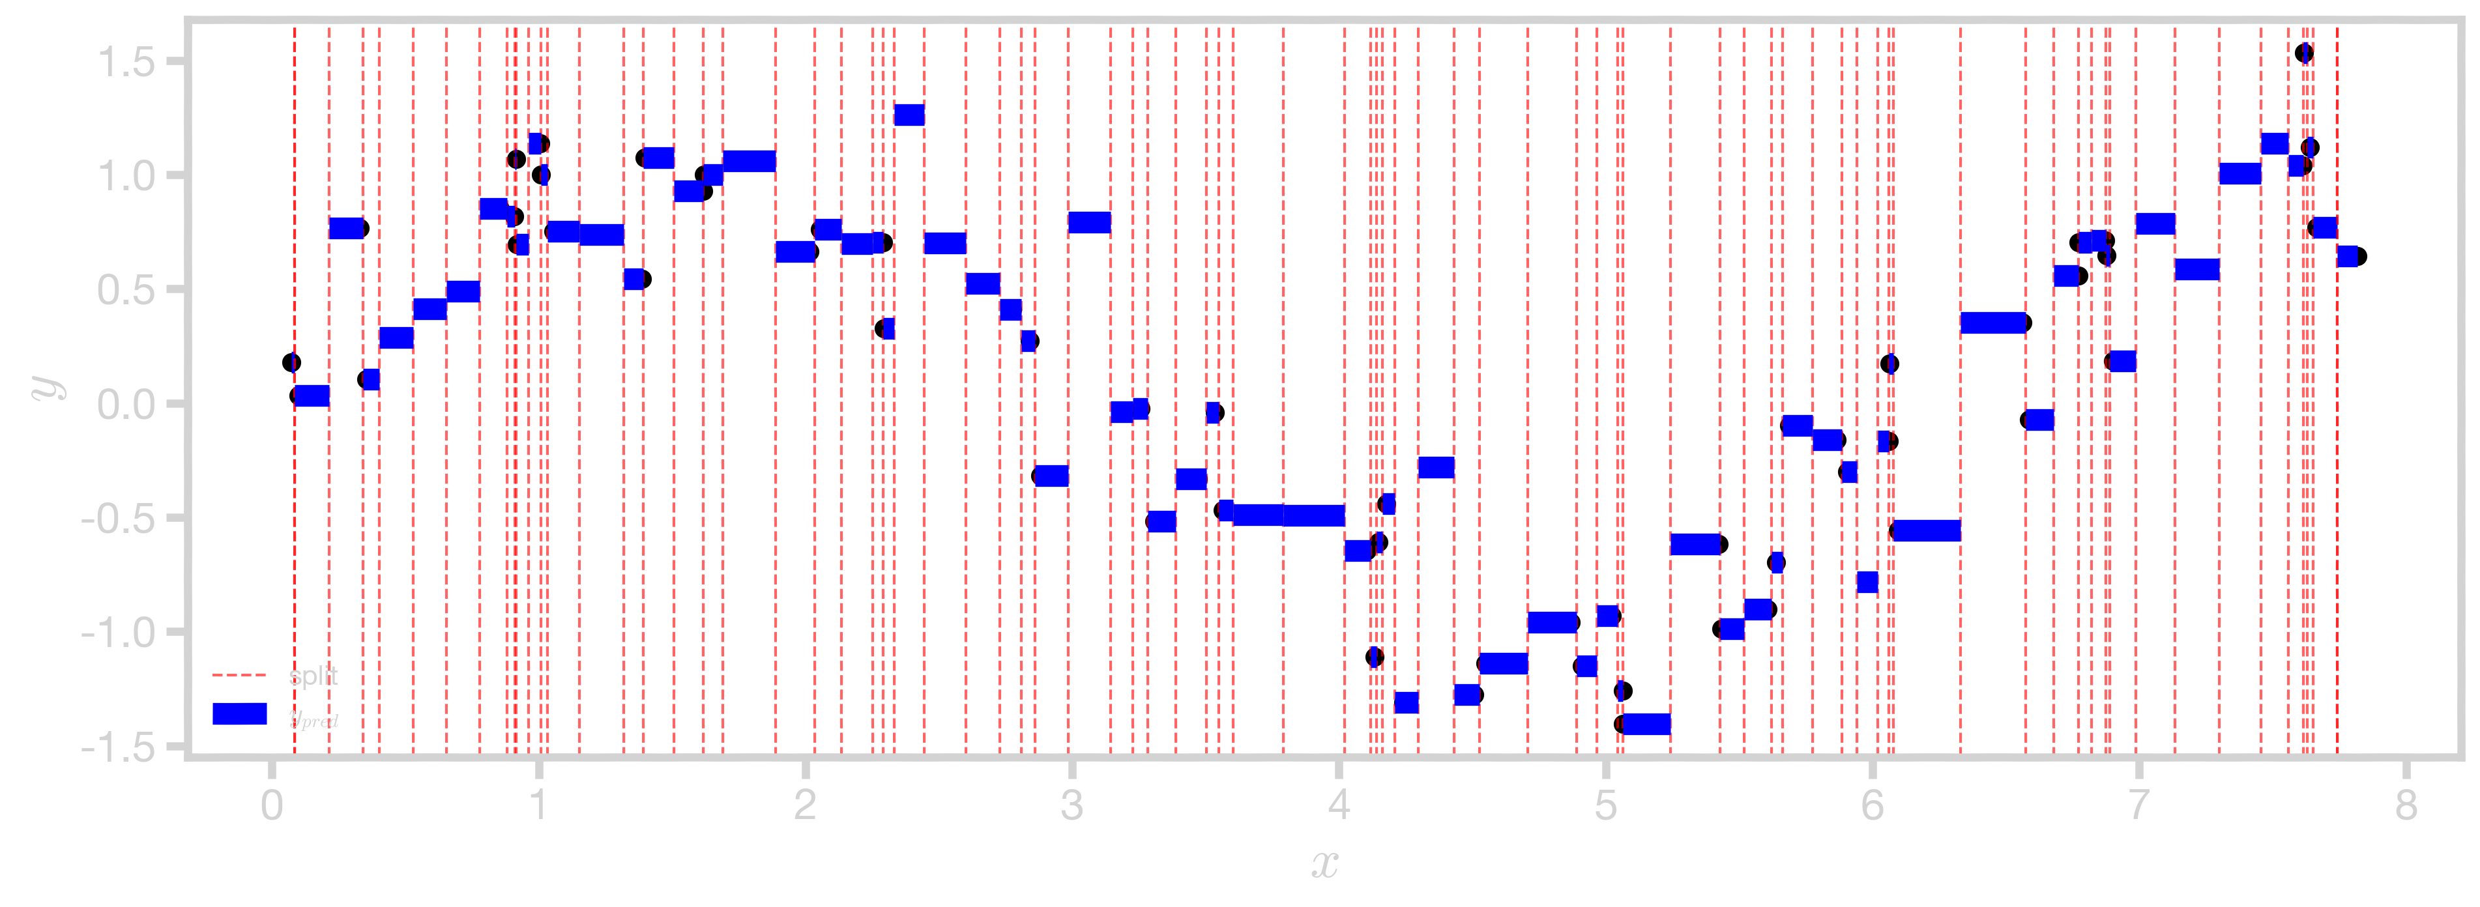
Regression Tree (max_depth = 10)

Slide 104


Stopping Conditions
Most of the stopping conditions we saw for classification trees can also be applied to regression.
In the place of purity gain, we can instead compute accuracy gain (in this case MSE reduction) for splitting a region $R.$
$$Gain\left(R\right)=Δ\left(R\right)=MSE\left(R\right)−\left(\frac{N_{1}}{N}MSE\left(R_{1}\right)+\frac{N_{2}}{N}MSE(R_{2})\right)$$
MSE without split
MSE after split

Slide 105

Stopping Conditions
Most of the stopping conditions we saw for classification trees can also be applied to regression.
Can you name them?
Are you even paying attention?

Slide 106

Thank you

